Slide 1
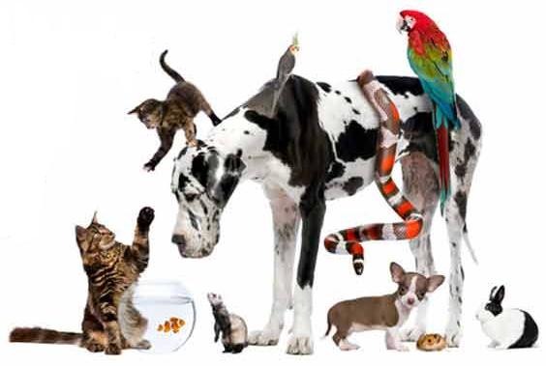

Animals and the ADA
by Mell Toy
800-949-4232  www.nwadacenter.org  nwadactr@uw.edu

Slide 2

A quick plug for the NW ADA Center
Housed under UW’s Center for Continuing Education (CCER)
Central office in Mountlake Terrace, WA
Affiliates in Alaska, Idaho, and Oregon
Grant-funded by National Institute on Disability, Independent Living, and Rehabilitation Research (NIDILRR)
Provide
  Technical assistance: free to anyone (call or email)
  Training to groups
  Material dissemination
  Research
  Public awareness

Slide 3
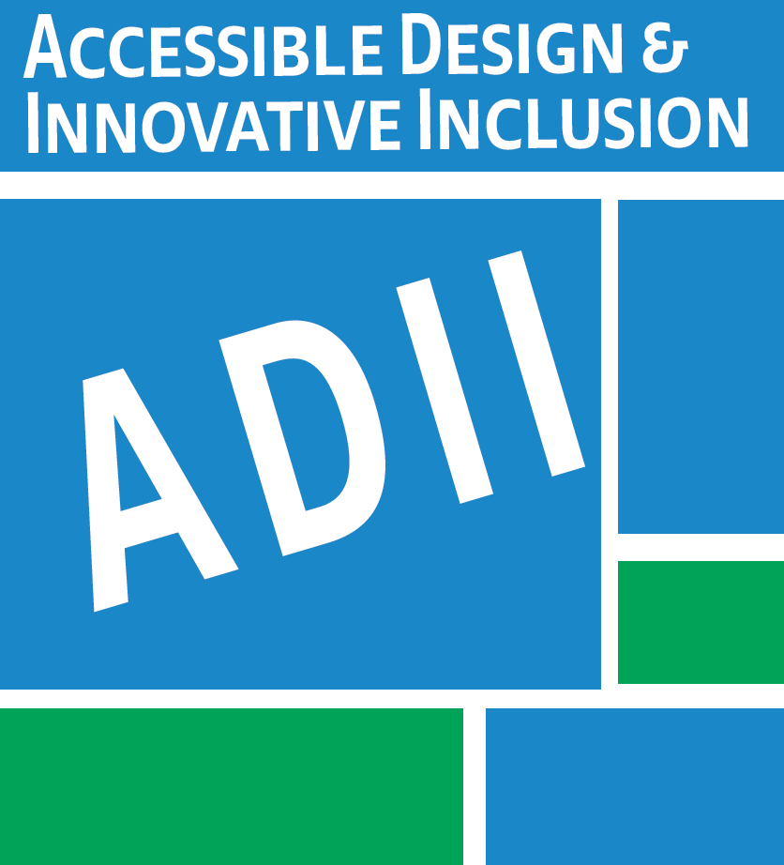
ADII accessibility site surveys
Accessible Design & Innovative Inclusion
ccer.org/adii
Site surveys
Floor plan, blue print review
Business policies, procedures advice
Federal and local laws, building codes
Competitive pricing
Notes:
serves a variety of customers such arts, parks & wildlife, corrections/jails, commercial, education, medical, lodging, retails, residential, and many more.
architectural design and construction design plan review
federal, state/local building codes to meet/exceed accessibility requirement

Slide 4
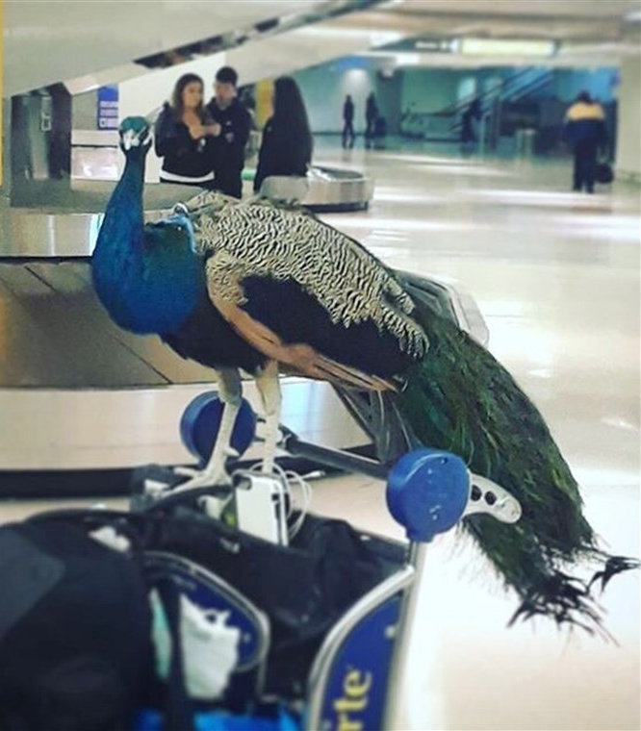
In the news (2015-2019)
Emotional support peacock’ barred from
United Airlines plane
Therapy Dogs Ease Students’ Exam Stress in
Chicago School
Man’s Emotional Support Alligator Loves to
Give Hugs
Pets help autistic kids improve social skills
Several states crack down on ‘fake’ service animals

Slide 5
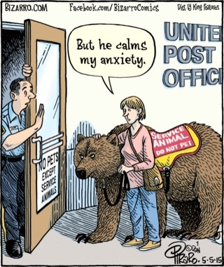
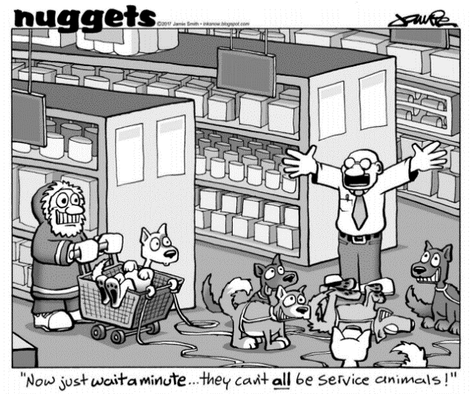
This is confusing!
Notes:
At the NW ADA Center, Consistently in the top 3 questions asked by customers and easily in the top 5 requested trainings from government agencies, business associations, and service organizations. If you run a google search on how often the phrase “service animal” is searched, you will notice a rise from 2006 to today. Peak is 100 Dec 2018. And for the phrase “emotional support animal,” a rise in frequency of search in Google from 2006 to today (Peak is 100 at Feb 2018)

Slide 6
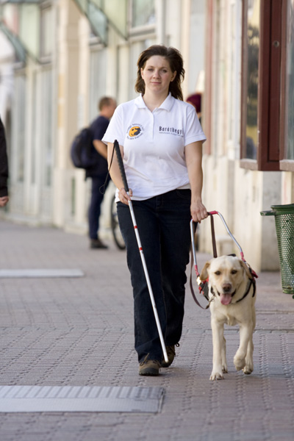
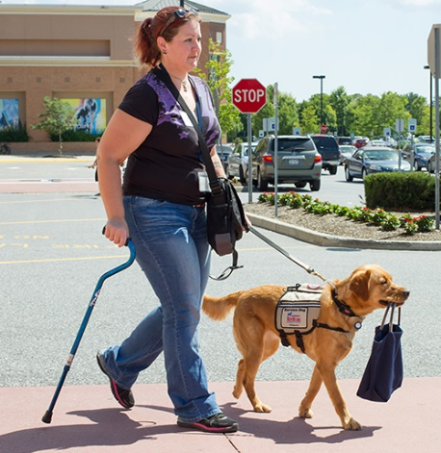
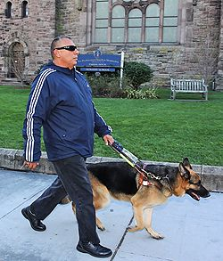
Gut check challenge: Do they have the right to enter?

Slide 7
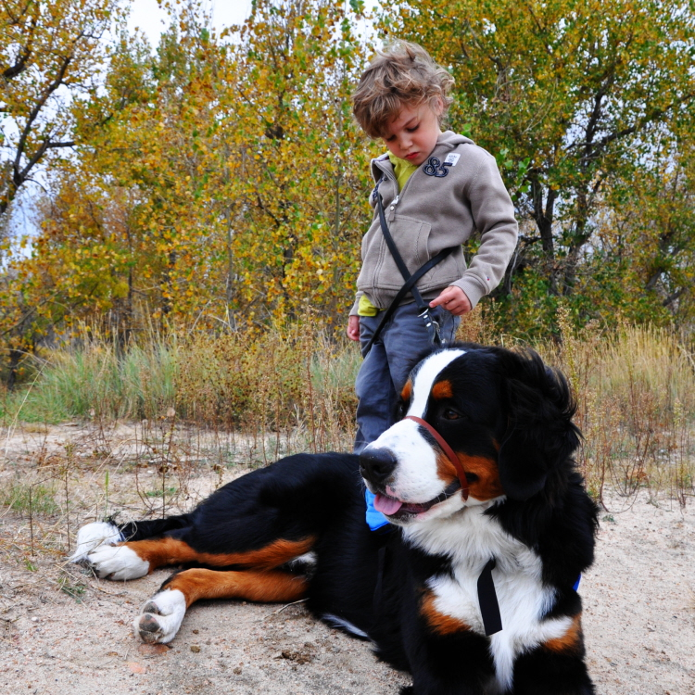
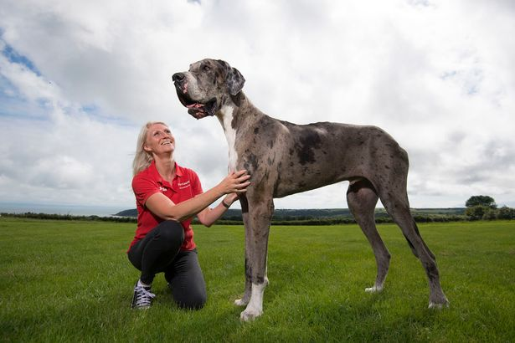
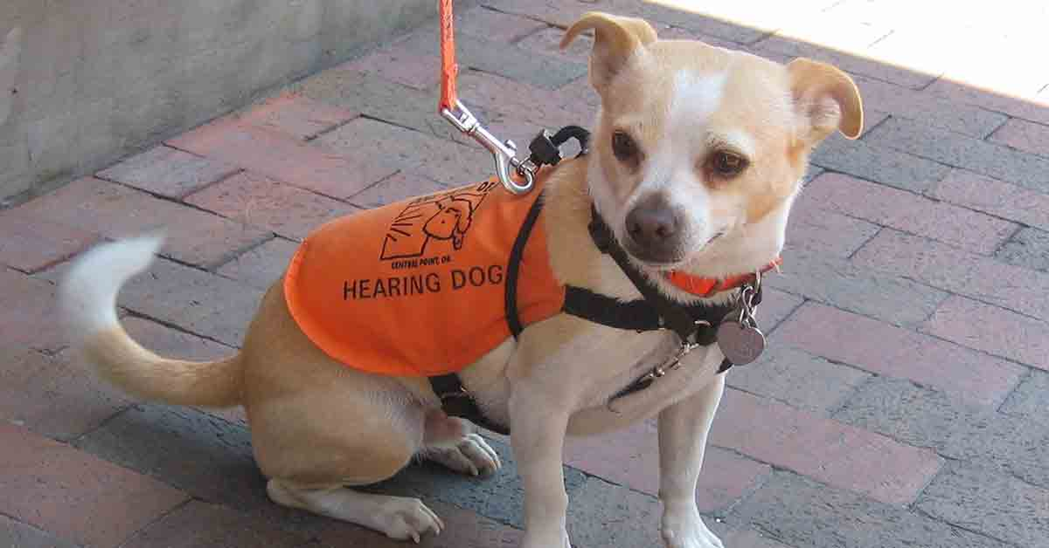
Does dog size matter?

Slide 8

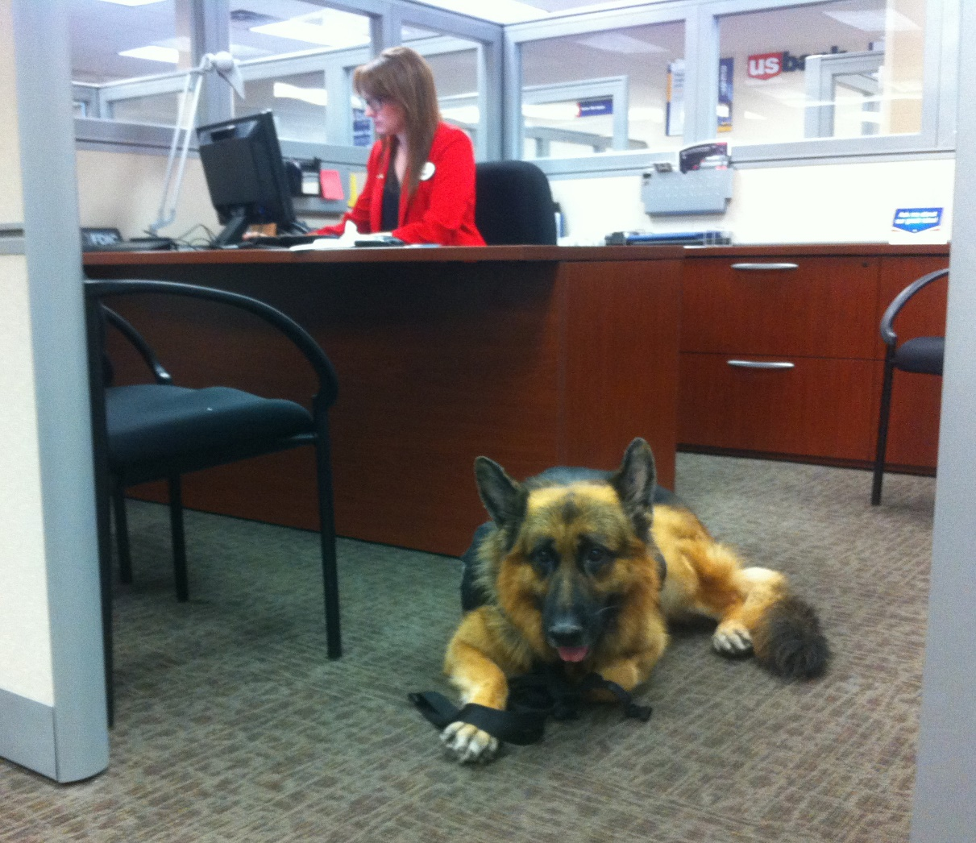
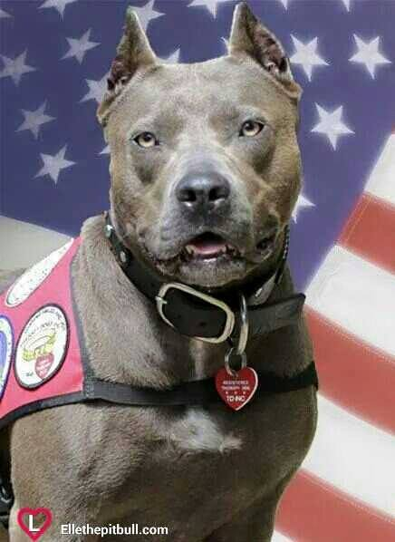
Does dog breed matter?

Slide 9
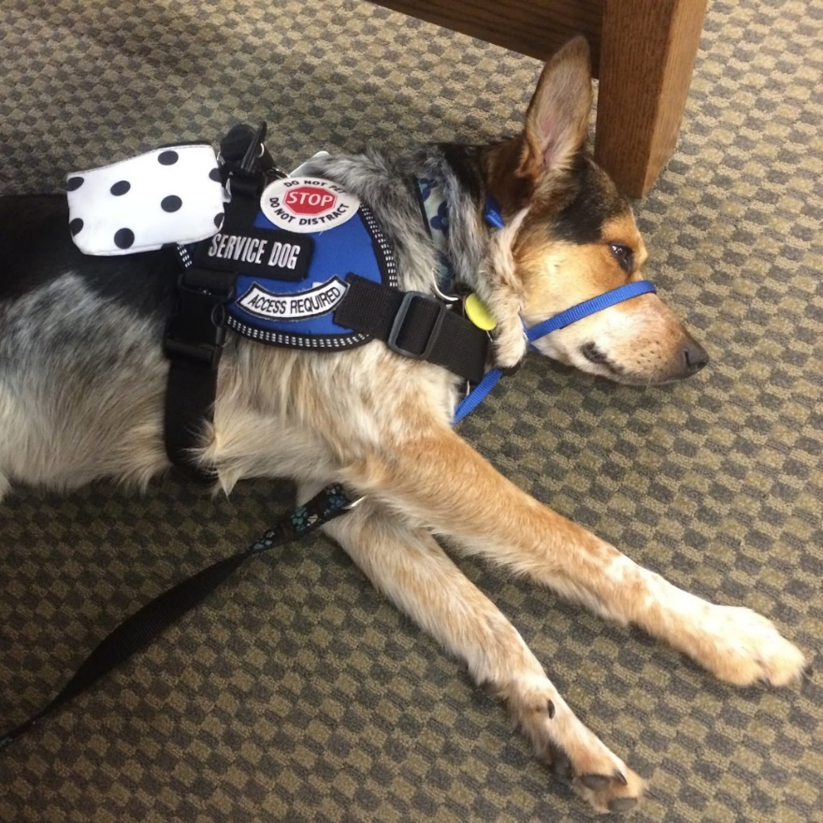
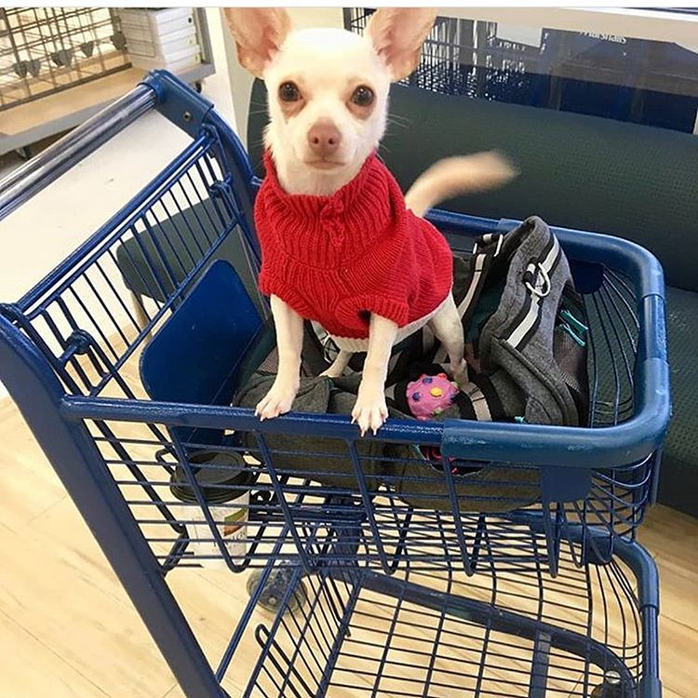
What if the dog isn’t working?

Slide 10
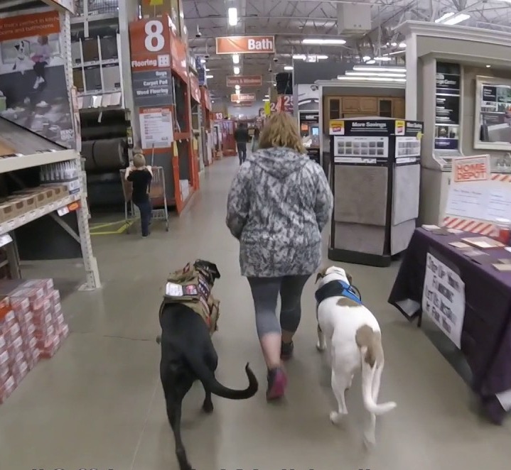
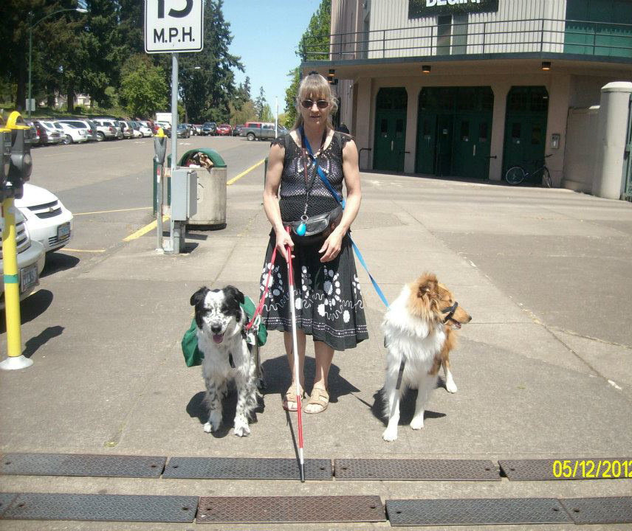
Does it matter how many animals you have?

Slide 11
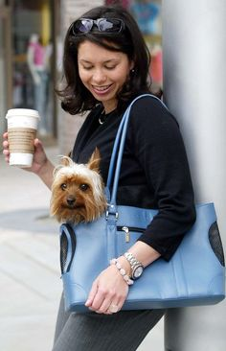
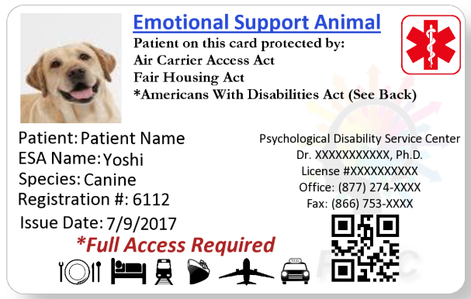
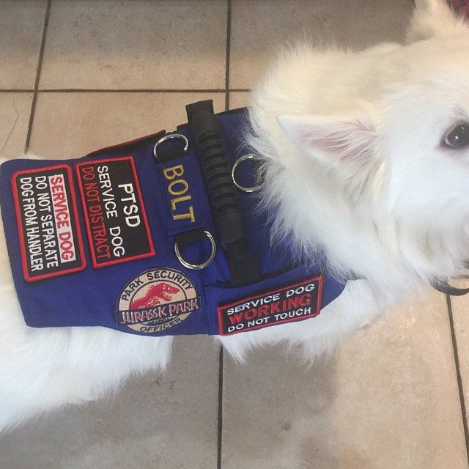
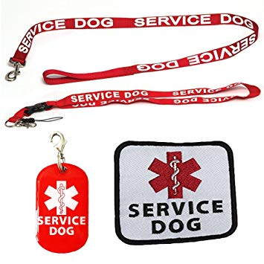
Does identification or special equipment matter?

Slide 12
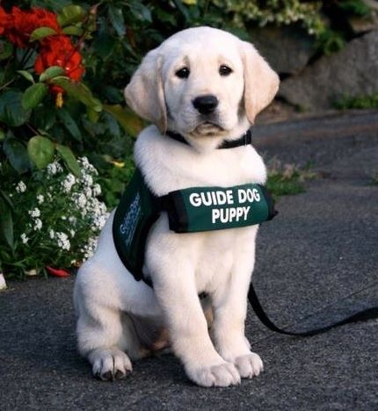
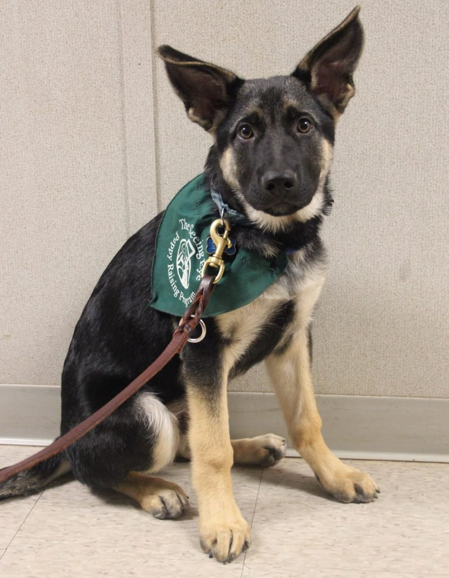
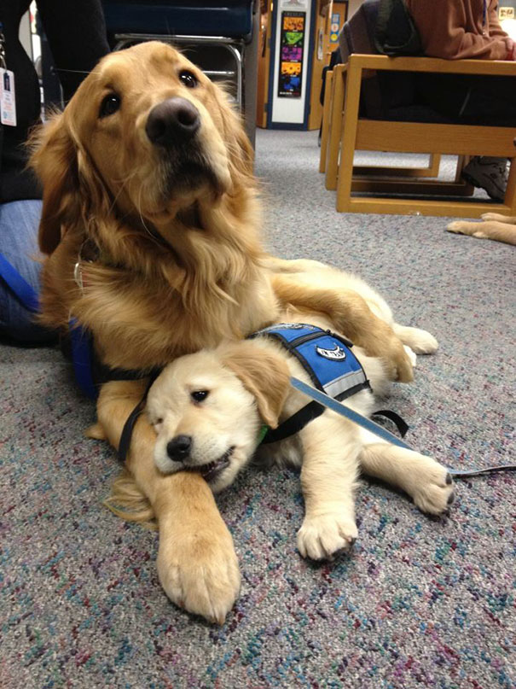
What about animals-in-training?

Slide 13
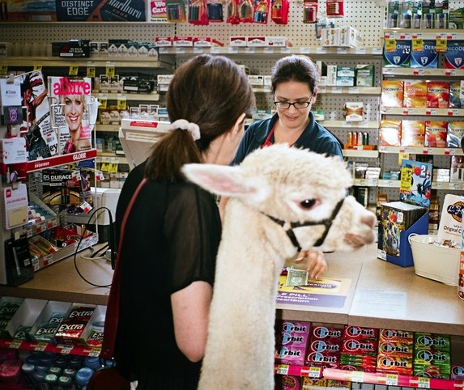
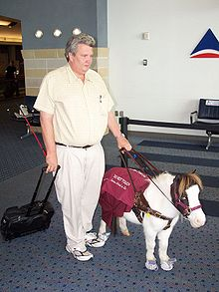
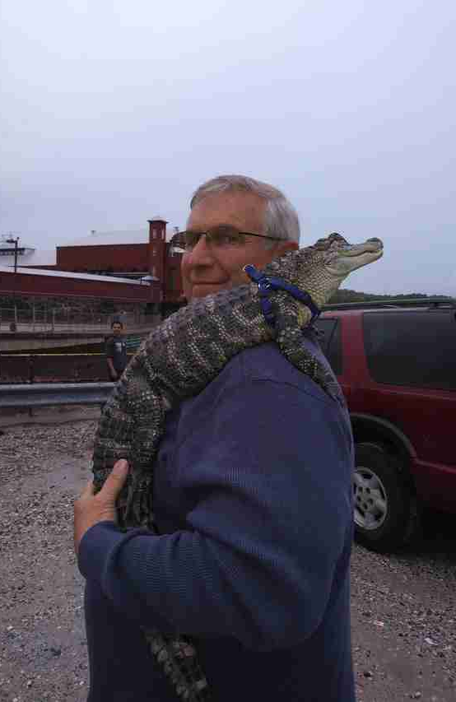
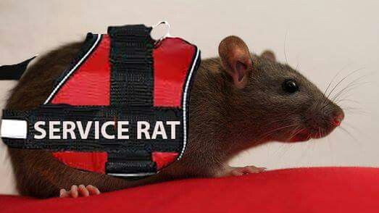
What about other animals?

Slide 14
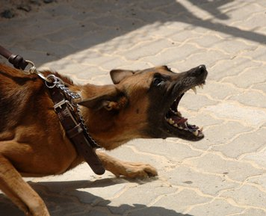
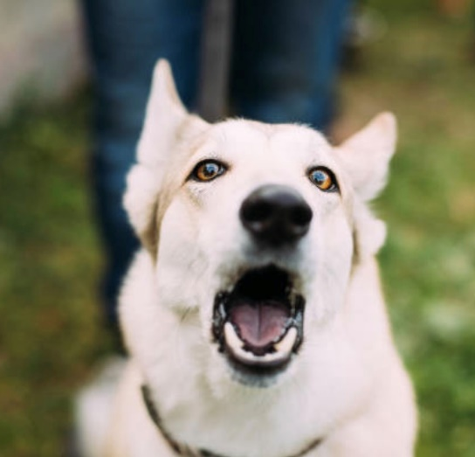
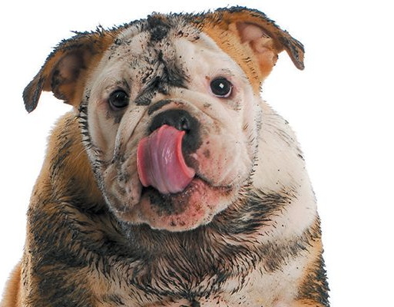
When can you legally prohibit the animal?

Slide 15

To answer the questions, look at the situation & laws
The Americans with Disabilities Act (ADA)
The Rehab Act of 1973
The Fair Housing Act (FHA)
Air Carrier Access Act (ACAA)
State and local laws

Slide 16
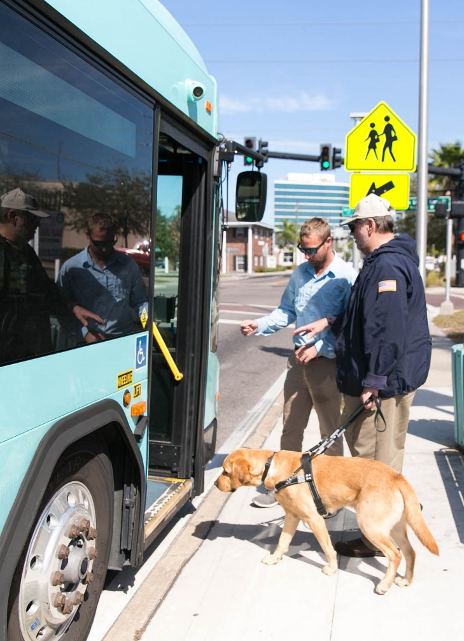
ADA
Employment (non-Federal/tribal)
“I need to bring my emotional support cat to work.”
Local, state government
“The Veteran wants to take his dog guide on the city bus.”
Businesses (open to the public)
“My daughter needs to bring her autism service dog into the bakery.”
Notes:
The ADA is the most comprehensive federal law promoting inclusivity of people with disabilities. It covers three general areas of everyday life. The parties with the responsibilities under the ADA are called “covered entities.” There are three general areas of everyday life, called titles of the ADA. Does anyone know Title I? How about Title II? Title III?

Slide 17
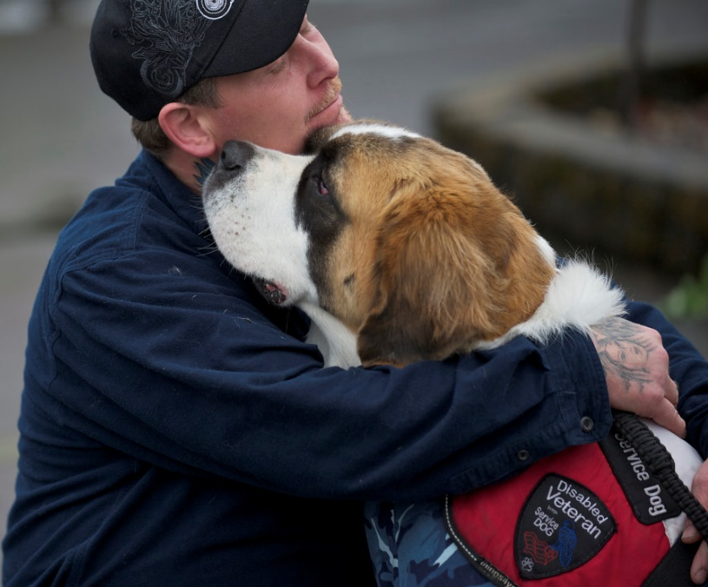
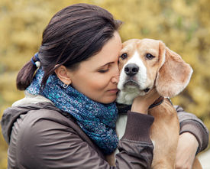
ADA service dogs
Any breed, any size
Fully-trained (not in-training)
Trained by anyone
Doesn’t have to be actively working
Can have more than 1 at a time, if each is trained to perform unique tasks
Certification, license, ID card, vest, patch/badge not required
Controlled (leash or voice)
Notes:
“a person who has a visual disability and a seizure disorder may use one service animal to assist with way-finding and another that is trained as a seizure alert dog. Other people may need two service animals for the same task, such as a person who needs two dogs to assist him or her with stability when walking.”

Slide 18
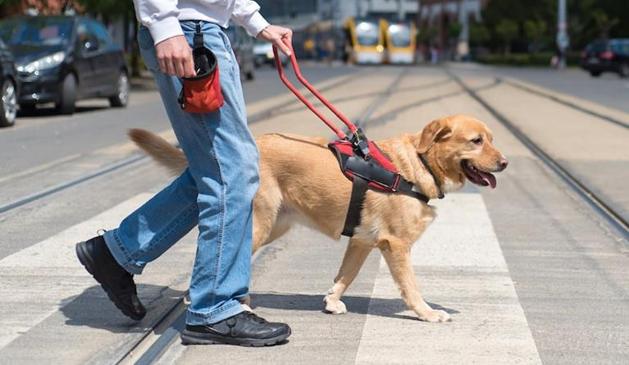
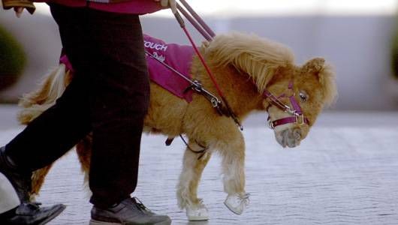
ADA definition of service animal
Working animals, not pets
individually trained to do work or perform tasks for people with disabilities.
The work or task provided must be directly related to the person’s disability
Dogs whose sole function is to provide comfort or emotional support do not qualify as service animals
Only two species – dogs and miniature horses
Notes:
Slide 11: ADA definition of service animal. The ADA is clear that * service animals are working animals, not pets. * They must be individually trained to do work or perform tasks for people with disabilities, * and this work or task must be directly related to the person’s disability. * If the only function of the animal is to provide comfort or emotional support, then it does not qualify as an ADA service animal. Also, the ADA recognizes only * two species that can be service animals –dogs and miniature horses. It is important to note that local laws may define service animals differently than the ADA does. A city, for example, may include emotional support animals as service animals in its definition, and the city may require that businesses permit these animals. There are two photos on this slide: Photo of a person walking in a marked crosswalk with a dog guide in harness. Below that, a photo of a person walking with a miniature horse in harness

Slide 19
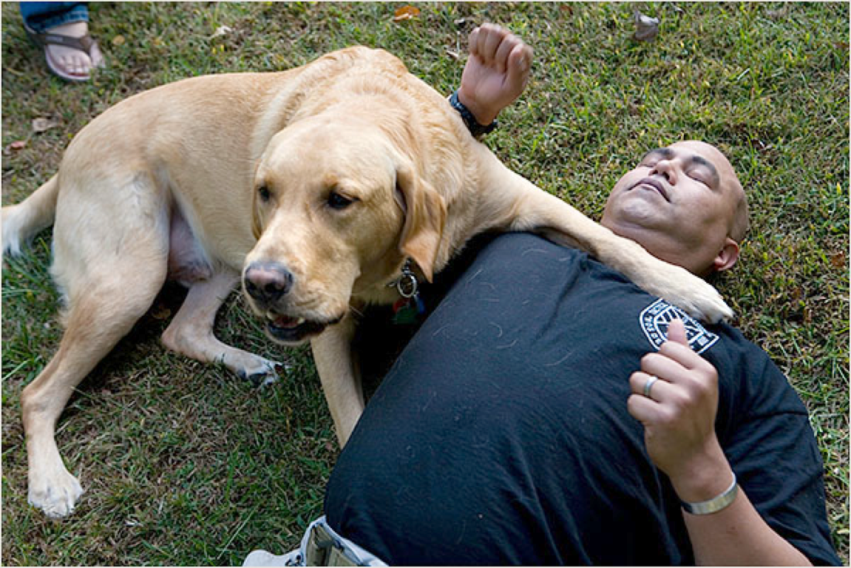
Example tasks
guiding people who are blind
  alerting people who are deaf
  pulling a wheelchair
  alerting and protecting a person who is having a seizure
  reminding a person with psychiatric disability to take prescribed medications
  calming a person with PTSD during an anxiety attack
  alerting a person with diabetes when blood sugar reaches high or low levels
  providing stability for a person who has difficulty walking
  picking up items for a person who uses a wheelchair

Slide 20
A tough one: Is this an ADA service animal?
“My dog calms me when I’m having an anxiety attack, and I want to bring it into the cafe.”
? Maybe
Need to ask The Two Questions.
Do you know what they are?

Slide 21
“My dog calms me when I’m having an anxiety attack, and I want to bring it into the cafe.”
Has this animal been trained to perform a task or tasks directly related to a disability?
If no (or not answered at all), then not an ADA service animal.
If yes, then ask question 2.
What tasks has this animal been trained to perform?

Slide 22
What tasks has this animal been trained to perform?
If answered with:
“The dog calms me by being around me.”
“The dog calms me when I hug him.”
Silence.
“The dog alerts me when my disability is going to flare and leans against my chest to lessen the impact.”
✗No
✗No
✗No
✓Yes
Notes:
DOJ: “if the dog's mere presence provides comfort, that would not be considered a service animal under the ADA.”

Slide 23

What about a business’s rights?
It is not the business’s responsibility to:
clean up after the animal
supervise the animal
feed or otherwise care for the animal
allow the animal in a shopping cart or on any furniture
Notes:
I want to be very clear on this. Excluding someone from dining, shopping, banking, recreating, voting, working, using community services, etc. because they have a disability is wrong.

Slide 24
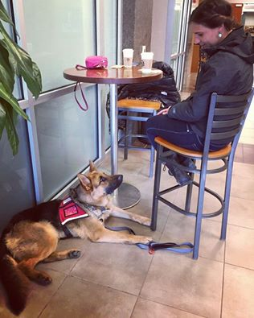

Food service and health code violations
True or false?
Due to the health code, restaurants and other food service businesses may (should) prohibit any animal even if it meets the ADA’s definition of a service animal.
Notes:
True or false?
Establishments that sell or prepare food must allow service animals in public areas even if state or local health codes prohibit animals on the premises.
Source: https://www.ada.gov/service_animals_2010.htm

Slide 25

Barking
True or false?
A business can ask a customer with a disability to remove an ADA service dog from the premises if the dog barks once.
Notes:
True or false? if a dog barks just once, or barks because someone has provoked it, this would not mean that the dog is out of control.
Source: https://www.ada.gov/regs2010/service_animal_qa.html (question 27)

Slide 26
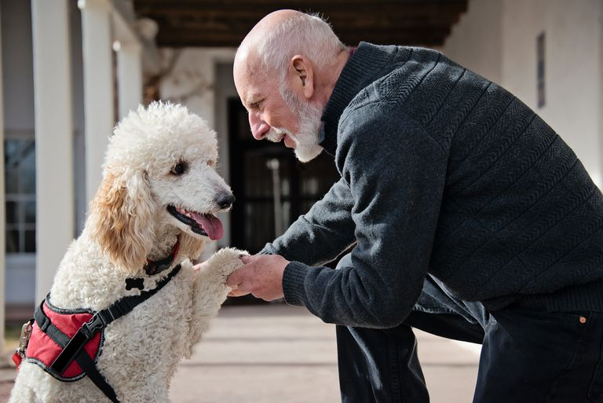
Leash
True or false?
A business can prohibit entry of an ADA service dog if it’s not on a leash.
Notes:
True or false?
Generally, the dog must stay on the floor, or the person must carry the dog. For example, if a person with diabetes has a glucose alert dog, he may carry the dog in a chest pack so it can be close to his face to allow the dog to smell his breath to alert him of a change in glucose levels.
Source: https://www.hum.wa.gov/sites/default/files/public/publications/DOJ%20Q%26A%20Service%20Animals.pdf
Q27. The ADA requires that service animals be under the control of the handler at all times...The service animal must be harnessed, leashed, or tethered while in public places unless these devices interfere with the service animal's work or the person's disability prevents use of these devices. In that case, the person must use voice, signal, or other effective means to maintain control of the animal. For example, a person who uses a wheelchair may use a long, retractable leash to allow her service animal to pick up or retrieve items. She may not allow the dog to wander away from her and must maintain control of the dog, even if it is retrieving an item at a distance from her. Or, a returning veteran who has PTSD and has great difficulty entering unfamiliar spaces may have a dog that is trained to enter a space, check to see that no threats are there, and come back and signal that it is safe to enter. The dog must be off leash to do its job, but may be leashed at other times.
https://www.ada.gov/regs2010/service_animal_qa.html

Slide 27
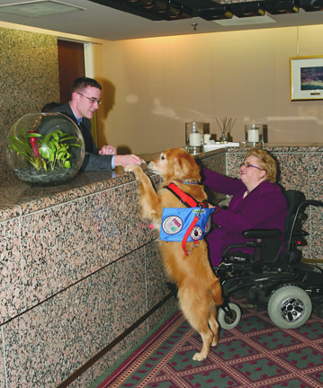

Pet fee policy
True or false?
If a business requires a deposit or fee to be paid by patrons with pets, it must waive the charge for service animals.
Notes:
True or false? In addition, if a business requires a deposit or fee to be paid by patrons with pets, it must waive the charge for service animals.
Source: https://www.ada.gov/service_animals_2010.htm
The ADA does not override public health rules that prohibit dogs in swimming pools. However, service animals must be allowed on the pool deck and in other areas where the public is allowed to go.
Source: https://www.hum.wa.gov/sites/default/files/public/publications/DOJ%20Q%26A%20Service%20Animals.pdf
& https://www.ada.gov/regs2010/service_animal_qa.html

Slide 28

A business may ask for removal of a service animal when the animal:
is not adequately groomed
has created a mess
is out of control, and the handler is unable to control it
is repeatedly barking, growling
is needlessly whining
has wandered (needless travel)
has given unwanted attention to others

Slide 29
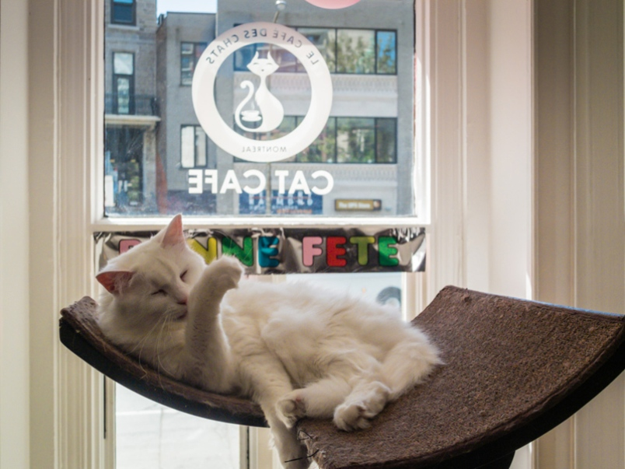
A business may bar an animal from entry when...
it can prove any one of the following:
the animal is not a service animal (by asking The Two Questions)
the presence of the animal would be a direct threat to others
the presence of the animal would fundamentally alter the business or program
Notes:
Direct threat – must be proven, not speculated. “It’s a pit bull! Of course it’s going to bite someone!” (other examples: zoo, cat café, sterile environment)
Fundamental alteration – so disruptive as to close the business (allergy-free restaurant) But business must be careful with these, and allow service animals into places customers can go up to the point that a direct threat or fundamental alteration will occur. When a business bars a service animal from entry, it must make every reasonable effort to accommodate the PWD. If a business can satisfy the 2nd or 3rd reason listed, it may not have to allow service animals period, and #1 wouldn’t matter. The business can write policy about service animals, and explain why they are not legally permitted. In these cases, we would encourage the business to have a sign on the door with brief explanation, and contact info for the person to call if there are questions or complaints about this policy.

Slide 30

If a service animal is denied,
a business must make a reasonable effort to accommodate the person with the disability so they can access the business’s goods and services.
Notes:
If a business decides to deny entry or ask the person to remove their service animal, the business cannot deny entry to the person with the disability. PWD still has rights to access goods/services, to participate, to be included. “When there is a legitimate reason to ask that a service animal be removed, staff must offer the person with the disability the opportunity to obtain goods or services without the animal’s presence.” (Source: https://www.ada.gov/service_animals_2010.htm)

Slide 31

Employment situations
Any species!
No disability-related training requirement!
Treat animals in the workplace as a reasonable accommodation request
Aforementioned limitations regarding animal’s behavior do apply
Notes:
1. in the workplace, there is no such definition and technically no limit to what type of animal can be a reasonable accommodation* 2. The employee may request, and the business may allow as an accommodation, an animal that does not meet the ADA definition of “service animal”.*

Slide 32
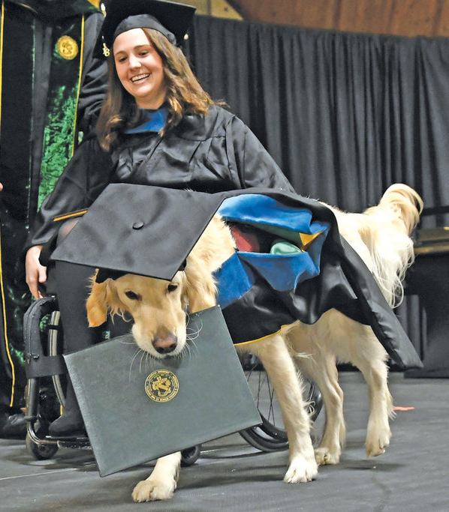
Congratulations!
You’ve completed your course on animals and the ADA.
Notes:
The PWD still has rights to access goods/services, to participate, to be included

Slide 33
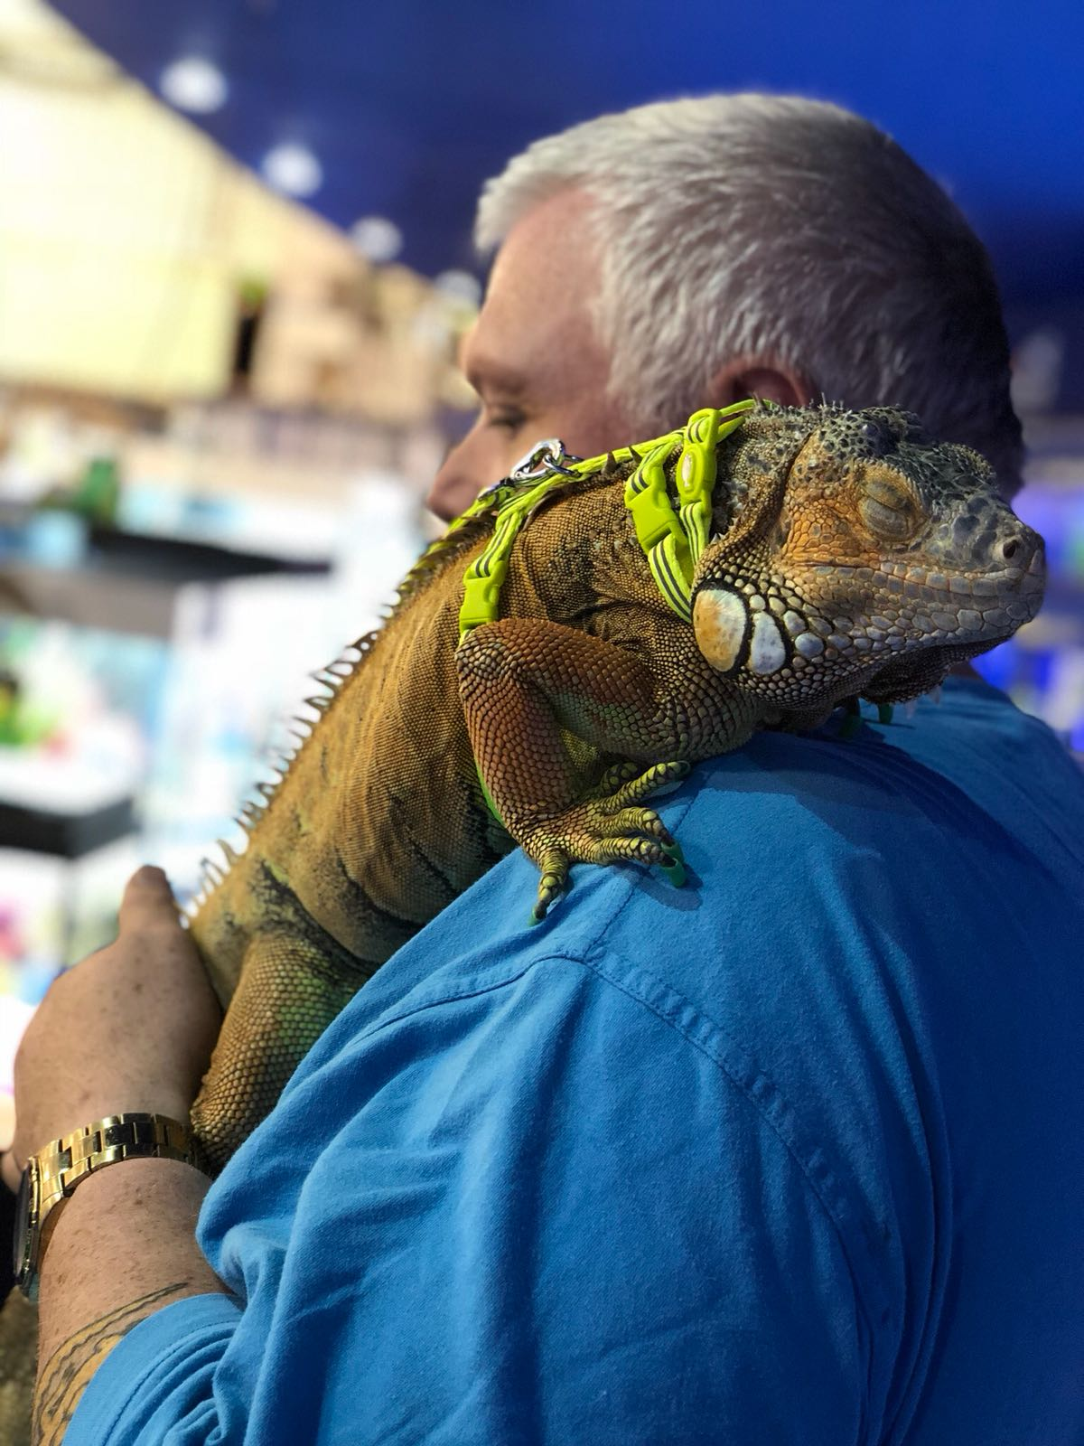
We’re not done yet
Remember the other laws?
If the animal doesn’t match ADA’s definition, you still need to check state, county, and city laws.
Notes:
In those same three areas of everyday life (titles I employment, title II state/local govt, and title III public accommodations), if the animal in question doesn’t match the ADA’s definition; you should check local laws. Local laws may provide additional protections to people who want to bring their animals into places of business, government buildings, and/or their place of employment.

Slide 34

Washington State definition of service animal
"Service animal" means any dog or miniature horse...that is individually trained to do work or perform tasks for the benefit of an individual with a disability, including a physical, sensory, psychiatric, intellectual, or other mental disability. The work or tasks performed by the service animal must be directly related to the individual's disability. The crime deterrent effects of an animal's presence and the provision of emotional support, well-being, comfort, or companionship do not constitute work or tasks. This subsection does not apply to...housing accommodations.
RCW 49.60.040 Effective Jan 1, 2019
Notes:
Very similar to ADA definition. A service animal must have training that sets it apart from a family pet; the service animal must be trained to engage in specific actions or tasks to assist its handler with a disability.
-Source: https://www.wla.org/assets/WALE/2015WALEConference/Service%20Animals%20and%20the%20Washington%20Law%20Against%20Discrimination.pdf
-Service animals in food service establishments: https://app.leg.wa.gov/rcw/default.aspx?cite=49.60.218
RCW 49.60.218
Use of dog guide or service animal—Unfair practice—Definitions. (Effective until January 1, 2019.)
(1) It shall be an unfair practice for any person or the person's agent or employee to commit an act which directly or indirectly results in any distinction, restriction, or discrimination, or the requiring of any person to pay a larger sum than the uniform rates charged other persons, or the refusing or withholding from any person the admission, patronage, custom, presence, frequenting, dwelling, staying, or lodging in any food establishment, except for conditions and limitations established by law and applicable to all persons, on the basis of the use of a dog guide or service animal by a person with a disability: PROVIDED, That this section shall not be construed to require structural changes, modifications, or additions to make any place accessible to a person with a disability except as otherwise required by law: PROVIDED, That behavior or actions constituting a risk to property or other persons can be grounds for refusal and shall not constitute an unfair practice.
(2) A food establishment shall make reasonable modifications in policies, practices, or procedures to permit the use of a miniature horse by an individual with a disability in accordance with subsection (1) of this section if the miniature horse has been individually trained to do work or perform tasks for the benefit of the individual with a disability. In determining whether reasonable modifications in policies, practices, or procedures can be made to allow a miniature horse into a facility, a food establishment shall act in accordance with all applicable laws and regulations.
(3) For the purposes of this section:
(a) "Service animal" means any dog that is individually trained to do work or perform tasks for the benefit of an individual with a disability, including a physical, sensory, psychiatric, intellectual, or other mental disability. Except as provided in subsection (2) of this section, other species of animals, whether wild or domestic, trained or untrained, are not service animals. The work or tasks performed by a service animal must be directly related to the individual's disability. Examples of work or tasks include, but are not limited to, assisting individuals who are blind or have low vision with navigation and other tasks, alerting individuals who are deaf or hard of hearing to the presence of people or sounds, providing nonviolent protection or rescue work, pulling a wheelchair, assisting an individual during a seizure, alerting individuals to the presence of allergens, retrieving items such as medicine or the telephone, providing physical support and assistance with balance and stability to individuals with mobility disabilities, and helping persons with psychiatric and neurological disabilities by preventing or interrupting impulsive or destructive behaviors. The crime deterrent effects of an animal's presence and the provision of emotional support, well-being, comfort, or companionship do not constitute work or tasks.
(b) "Food establishment" means a place of business that sells or serves food for human consumption with a North American industry classification system code

Slide 35

King County definition of service animal
“a dog guide, signal or hearing dog, seizure response dog, therapeutic companion animal or other animal that does work, performs tasks or provides medically necessary support for the benefit of an individual with a disability.”
KCC 12.22
Ord. 15399 § 60, 2006: Ord. 8625 § 1, 1988
Notes:
Broader than the ADA. Gives additional protection to animals that aren’t ADA service animals. Under King County ordinance, companion or therapeutic assistance animals are considered to be service animals. So which law overrides the other?
Source: https://www.kingcounty.gov/~/media/exec/civilrights/documents/SApublic.ashx

Slide 36

Seattle definition of service animal
‘“Service animal” means an animal that provides medically necessary support for the benefit of an individual with a disability’
Title 9
Animals 9.25.023
Definitions, part D
Notes:
Broader than the ADA’s definition. Service animals are broadly defined in Seattle and include therapy, emotional support, companion animals and more.”

Slide 37

Benton County definition of service animal
“trained dog guide or service animal”
Resolution 08 750
Notes:
https://www.co.benton.wa.us/files/documents/EEOCPolicy126053120062918PM.pdf

Slide 38

Richland definition of service animal
“trained dog guide or service animal by a person with a disability”
A Proclamation of the City of Richland
November 21, 2017
Notes:
Similar to ADA’s definition. Source: https://www.ci.richland.wa.us/Home/ShowDocument?id=5267

Slide 39
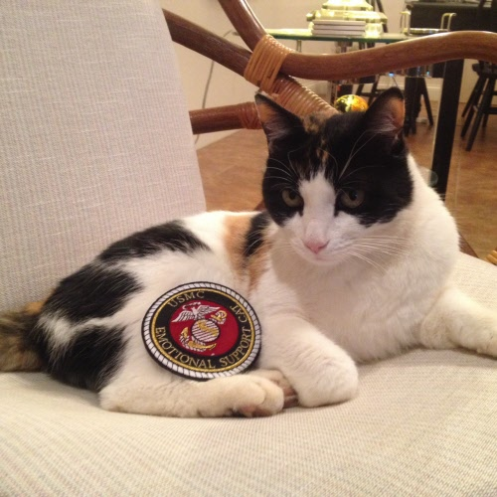
Fair Housing Act
Housing
‘I need my emotional support cat with me in my new apartment, but my lease says, “no pets.”’

Slide 40
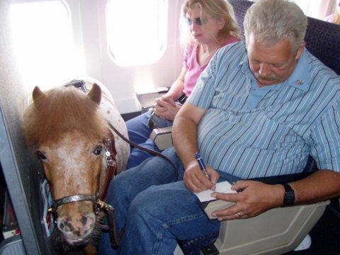
Air Carrier Access Act
Flying on any US airline
“I need my miniature horse to guide me onto and off of the airplane.”
Notes:
With so many different laws, wouldn’t it be nice to have a chart to cross-reference?

Slide 41
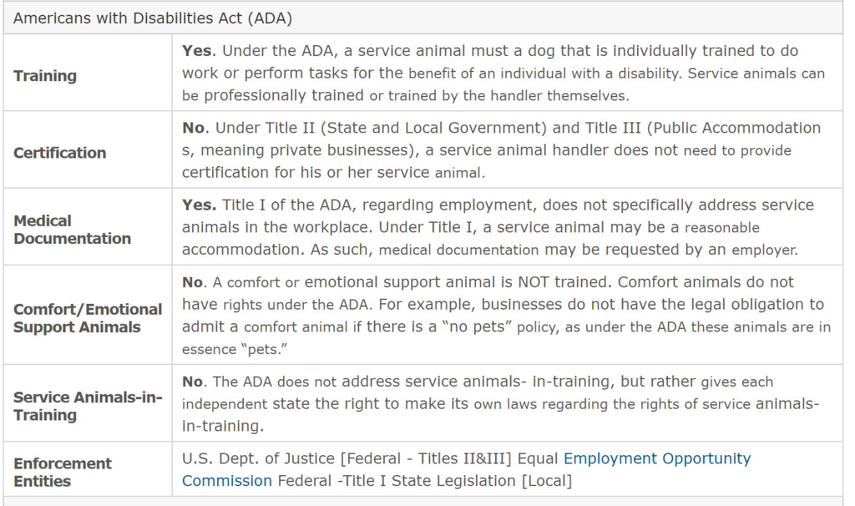
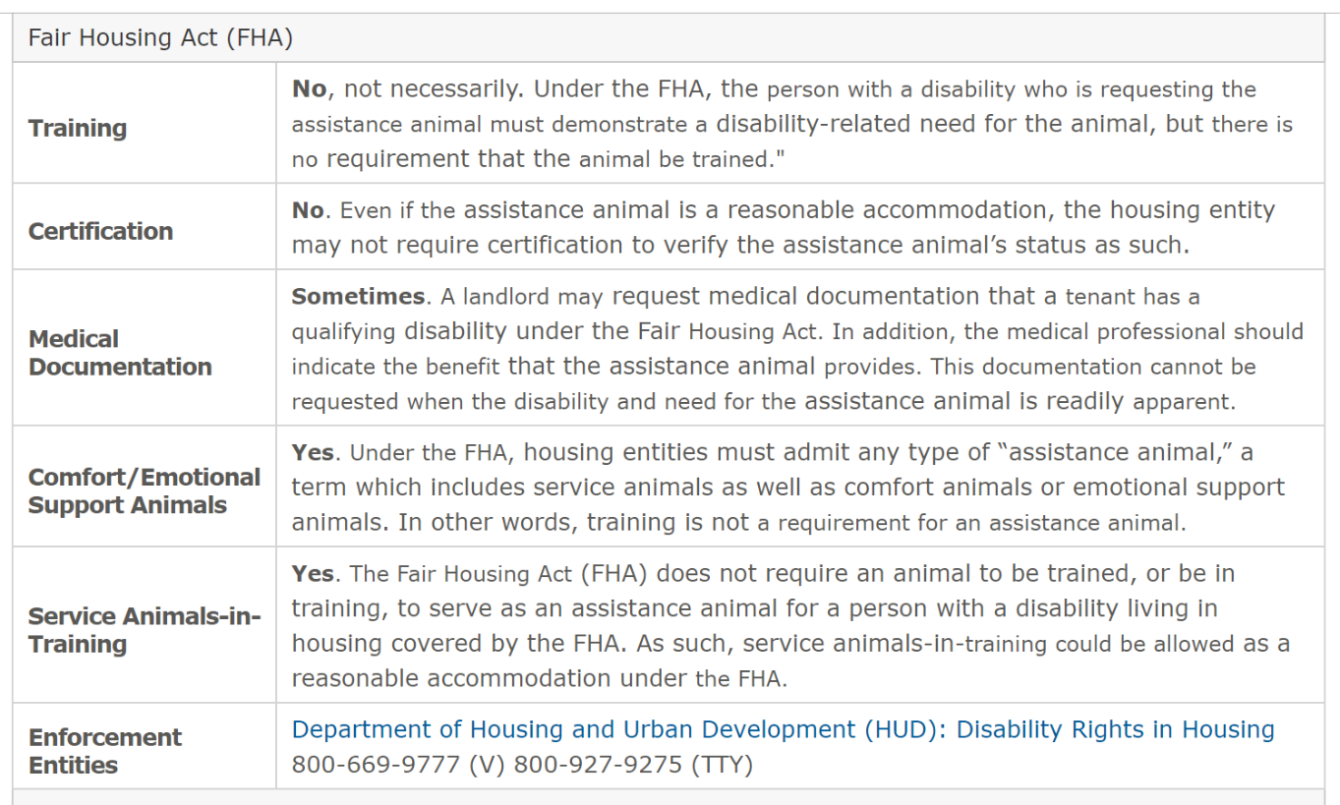

Service Animal Comparison Chart
www.nwadacenter.org/factsheets, click:

Slide 42
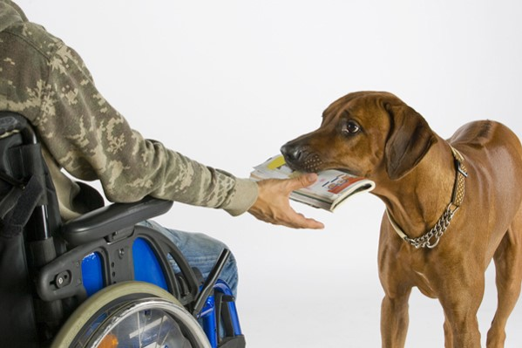
References
"Frequently Asked Questions about Service Animals and the ADA," US Dept of Justice, Civil Rights Division
"Service Animals," US Dept of Justice, Civil Rights Division
Service animals as a Reasonable Accommodation, Northwest ADA Center
Service Animals Comparison Sheet, Northwest ADA Center

