Slide 1
Veteran Homelessness
Stephen McGuire, MPH
VSO
Spokane Regional Veteran Services

Slide 2
Objectives
Better understand the epidemiologic characteristics, health concerns and outcomes for homeless veterans
Identify opportunities to improve health outcomes for rural veterans
Describe the function of the VA National Center on Homelessness Among Veterans

Slide 3
Homeless
Defined
HUD established definitions of homelessness
Four categories
  Literally homeless
  Imminent risk of homelessness
  Homeless under other federal statutes
  Fleeing/Attempting to flee DV
Notes:
Literally: individual or family who lacks a fixed, regular and adequate nighttime residence
primary nighttime residence is public or private place not meant for human habitation
Imminent: individual or family who will imminently lose their primary nighttime residence
residence lost within 14 days, no subsequent residence identified, lacks resources to or support network to obtain other permanent housing
Unaccompanied youth under 25 or families with children and youth who do not otherwise qualify as homeless under this definition

Slide 4
National Numbers
Any given night: 37,800 vets are homeless
23,300 were unsheltered or living on the streets
5.4% decrease year over year
Nearly 50% decline since 2010
3 States and 67 communities announced end to Vet homelessness
“Functional Zero”
Notes:
Connecticut, Delaware, Virginia as of April 25, 2019.
What is functional zero? “Functional zero is reached when the number of veterans experiencing homelessness within a community is less than the average number of veterans being connected with permanent housing each month. In achieving this measure, a community has demonstrated the system and capacity to quickly and efficiently connect people with housing and ensure that veteran homelessness within the community will be rare, brief, and non-recurring.

Slide 5
Epidemiology of Vet Homelessness
91% Male 9% Female
8% Hispanic 92% Non-Hispanic
50% White, Non-Hispanic 5% White, Hispanic 39% Black or AA
Predominantly 31-61 years of age
Female risk of homelessness
OIF/OEF vets
Notes:
Females had a higher risk of becoming homeless (7.6% vs 4.5%). Black or AA demographic were more likely (9.5 to 4.9) to be homeless. Divorced or never married nearly 3x as likely to be homeless as opposed to married folks. Individuals with a service connected disability were 2x as likely to be homeless than those that were not SC. (7.2 to 3.6)
OIF/OEF vets had a shorter median time to homeless post service and also had a higher incidence. Potential explanations for this is due to the younger age these vets are separating (typically E1-E4).

Slide 6

Washington State Numbers
Down 21.8% from previous year
Up 10% from 2011
Variance in State data
Kittitas County announced end of Vet homelessness
Notes:
You have noticed the fluctuation across your own CoCs or Case Conferencing meetings that capturing homeless veteran data on the ground is challenging. Combine that with the different data management systems and their ability to deliver the proper readouts (reference our case conferencing challenges with getting HMIS to work)

Slide 7
Sheltered and Unsheltered Across CoCs
Notes:
WA has 6 (down from 7 in 2017) federally recognized CoCs. Vancouver Clark, Everett/Snohomish, WA Balance of State (encompasses 34 counties, does decision making on project funding, development of statewide strategies, coordinate the PIT, manage HMIS database, strengthen coordination between CoC funded activities and other HUD funded activities, monitor grantees), Seattle/King, Tacoma, Lakewood/Pierce, Spokane City and County. Combined HUD has identified 1636 homeless vets. Yakima city & county CoC was dropped in 2018

Slide 8

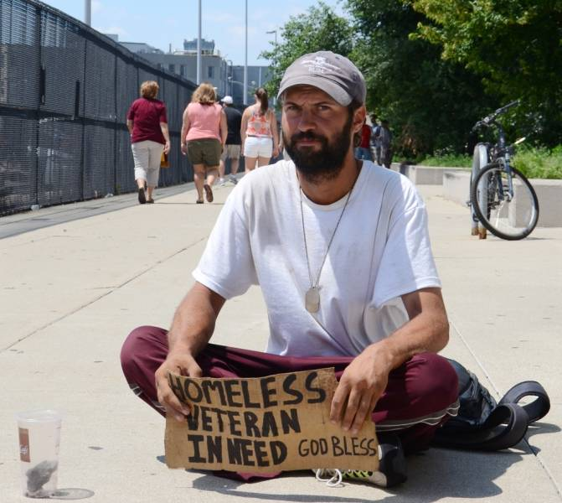
Health Risks of Being a Homeless Vet
Similarities between homeless and non-homeless
Younger vets
Older vets
Notes:
Similarities in both groups in terms of cause of death (76% to 83%) from five major causes (CVD, cancers, external causes, infection and parasitic diseases, disorders of digestive system). Major difference in early death from external causes such as drug overdose, suicide, homicide and vehicular non-vehicular accidents such as falls, drowning, errors in operating machinery)
In a first of its kind study conducted comparing homeless vets to non homeless vets between the ages of 30-54, a large sample of 65,198 age matched vets were followed for 11 years. At the time of follow up 16.3% of the homeless vets had died and only 6.4% of the non-homeless vets has passed. Homeless vets were 2.5x as likely to pass and twice as likely to pass compared to the national death estimates. This means that simply by being a veteran, you are at a higher risk of early death than our civilian counter parts.
Older vets, in a similar age matched study, demonstrated a 35% vs 18% (nearly 2x as likely) death rate among these older vets. Average age of homeless older vet death was 65.0 and 66.9 average for non-homeless vets.

Slide 9
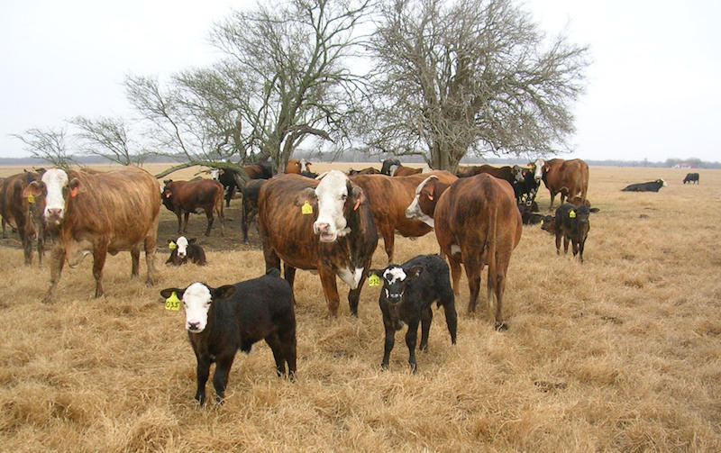
Rural Veterans
Rural veteran characteristics
Higher rates of homelessness
Service utilization
Notes:
Rural vets tend to be older, married and residing in their state of birth. Have higher rates of unemployment. More likely to own their own home, quality and value of the home is lower. Rate of mental health conditions is higher than that of urban vets
¼ of veterans live in rural areas compared to 18% of all Americans. ½ of all rural vets are over 65 and 40% have a SC disability.
These vets have more frequent access to health insurance than their non vet counterparts. They utilize emergency rooms at a higher rate than their urban counterparts, and on average, have a higher cost per visit which demonstrates a need for urgent care or smaller clinics. Travel mainly to urban areas for mental health treatment which means higher costs.

Slide 10
HERS Proceedings
Homeless Evidence and Research Synthesis
Evidenced based programs and solutions
VA National Center on Homelessness Among Veterans
Focused on four key areas
  Population based studies
  Physical and mental health
  Program evaluation
  Functioning and flourishing
Notes:
Findings are disseminated through peer reviewed publications, reports, manuals, symposium proceeding and briefs. Has two ongoing webinars focused on using research findings to inform policy and to influence practice.

Slide 11
Opportunities for Rural Vets
Programs to allow vets to stay in their home
Reorganize VHA Homeless Programs
Alternate definition of homeless in the rural context
Better integration of vets into rural communities post-service
Notes:
Rural vet programs to increase weatherization, repairs, heating installation and making homes disability friendly.
Co-locating with other resources to be responsive to rural vet needs. Pursue other avenues of communicating with rural vets about program services because 43% of rural vets lack internet access
False distinction between rural poverty and homelessness. Include poverty as part of a broader definition of housing insecurity in rural areas.
Pilot program currently being conducted to assess the needs of service members who are transitioning into rural communities after release from service. Attempt to identify where resources are lacking, barriers to care and awareness of homeless prevention.

Slide 12









Thank You

Slide 13
Using the SOAR Model to Assist Veterans
SSI/SSDI Outreach, Access and Recovery (SOAR)
Deanna Ballard, Community Services Division, Department of Social & Health Services
Notes:
Hello! My name is Deanna Ballard and I’m a SOAR co-lead for Washington State. SOAR stands for SSI/SSDI , Outreach, Access, and Recovery.
My experience assisting individuals to apply for SSI started as an SSI Facilitator over 10 years ago. I worked as a social worker for several years until I had an opportunity to develop training for social workers in the Community Services Division, including SSI Facilitators. This experience really helped me gain a better understanding of how SSA, DSHS, and SOAR providers can work together to assist individuals applying for SSI.

Slide 14

What is SOAR?
A model for assisting eligible individuals to apply for Supplemental Security Income (SSI) and Social Security Disability Insurance (SSDI)
For individuals who are experiencing or at-risk of homelessness and have a serious mental illness, co-occurring substance use disorder, or other physical disabilities
Sponsored by the Substance Abuse and Mental Health Services Administration (SAMHSA) in collaboration with the Social Security Administration (SSA) since 2005
All 50 states and Washington, D.C. currently participate
Notes:
The SOAR model is a tool for case managers or local providers to use when assisting people to apply for Supplemental Security Income (SSI) and Social Security Disability Insurance (SSDI). The SOAR model focuses on helping those who are experiencing or are at risk of homelessness and have a mental illness, medical impairment, and/or a co-occurring substance use disorder
SOAR is sponsored by SAMHSA and SSA. All 50 states and D.C. participate in using the SOAR model.

Slide 15
SOAR Has Broader Goals
Housing
Access to treatment & other services
Employment Opportunities
Community Investment
Decrease in incarcerations & hospitalizations
SOAR
Notes:
SOAR is not just about getting the SSI check…SOAR has broader goals.
While SSI is not necessarily the end goal, receiving stable assistance increases the chances of obtaining housing, employment, and access to treatment.
Stability also decreases the rate of hospitalizations and incarceration. SOAR is truly a community investment.

Slide 16

Definition of “Homelessness”
The label “SOAR” should only be used on SSI/SSDI applications for persons who are homeless or at risk for homelessness.
Homeless | At-Risk for Homelessness
Moving from place to place throughout the month Living in uninhabitable housing, outside or in shelters Living temporarily “doubled-up” Living in hotels and motels paid for by Federal, State, or local government programs | Living in unstable or non-permanent housing Exiting institution with no stable place to live Permanent housing for those recently experiencing homelessness with limited income or relying on grant funding to sustain housing Youth transitioning out of foster care
Notes:
We can use the SOAR indicator/label when working with SSA for those who meet PATH’s definition of “Homeless”. This includes “literally” homeless and “imminent risk”. The differences include (list).
SOAR is also appropriate for individuals who are being served by Supportive Services for Veteran Families, HUD-VASH (supportive housing for Veterans), Housing First, and other Permanent Supportive Housing for those who were recently experiencing homelessness, and who are relying on grant support or have limited income to sustain their housing.

Slide 17
SSI & SSDI: The Basics
Supplemental Security Income (SSI)
Needs based; federal benefit rate is $771 (2019); provides Medicaid in most states
Social Security Disability Insurance (SSDI)
Amount depends on earnings put into SSA system; Medicare generally provided after 2 years of eligibility
Notes:
The SOAR model assists individuals with both the SSI and SSDI application. SSI is a needs based program and provides benefits to individuals who are disabled, blind, or elderly with limited income and resources and who do not have qualifying work quarters for SSDI. There are limits on resources and assets for SSI. Medicaid (Apple Health for WA) comes with SSI.
SSDI is a benefit provided to blind or disabled individuals who are “insured” based on contributions paid into Social Security through employment. There are no resource limits for SSDI. Medicare comes with SSDI, but you have to wait 2 years with only a couple of exceptions.

Slide 18


SSI/SSDI Eligibility
SSA’s Definition of Disability
Medical Condition(s)
Functional Impairment(s)
  Diagnosis
  Documentation
  Duration
  Severity
  Work
  SGA
Notes:
Social Security defines disability as being unable to work due to a medically determinable physical or mental impairment that’s expected to last one year or result in death.
SSA contracts with an adjudicator at Disability Determination Services, who will look for the following:
A diagnosis from their list of acceptable medical sources
Documentation (labs, clinical findings, history)
That the medical condition has lasted or is expected to last for a continuous period of at least 12 months OR result in death.
They also consider the ability to function: What can the individual can do despite their impairment and is there evidence that supports their functional limitations? When evaluating disability, the adjudicator will consider work the individual has performed within the last 15 years.
They also consider the ability to engage in substantial gainful activity (SGA). If the individual makes less than 1,220/month (2019), they could still potentially qualify for SSI while working. There are employment programs such as Ticket to Work and other incentives that SSA offers to those who can work. According to SAMSHA’s research, about 70% of adults with serious mental illness desire to work. So, it’s important that we educate veterans that they can work and receive SSA disability benefits.
A SOAR trained provider can help tremendously with all aspects of the application including providing information on these eligibility factors.

Slide 19
SOAR Partners
SSA
Social Security Administration
DDS
Disability Determination Services
State agency under contract to SSA
Federal agency that administers SSI/SSDI
Makes the non-medical decision
Makes the medical/
disability determination
Medical
Medical records
Assessments/evaluations
Medical/
Treatment providers
You
SOAR trained case managers are actively involved every step of the process
Notes:
At a glance, you can see that SOAR does not function in a vacuum. We rely heavily on our community partners.
First, the Social Security Administration (SSA). SSA is the federal agency that administers SSI and SSDI. Because SSA is federal, their eligibility rules are the same in every state. Remember, SSA makes the non-medical decision on the claim.
Disability Determination Services (DDS) works in partnership with SSA to make the medical or disability determination.
Medical and treatment providers are extremely important. A SOAR provider will need access to assessments, evaluations and the corresponding medical records to support the SSI claim. This can be really overwhelming to an individual applying for SSI on their own. I’d also like to include community partners from criminal justice organizations, Veterans Affairs, employment programs, housing providers, DSHS, and others to ensure that individuals served by SOAR are receiving comprehensive services and supports.
Finally, you! People in our communities who are interested and willing to be SOAR trained.

Slide 20
Importance of SSI/SSDI for Veterans
SSA disability benefits can provide access to:
      Income: Veterans can receive SSI/SSDI in conjunction with, or as an alternative to, VA disability benefits
      Health insurance: Veterans can use the Medicaid and Medicare health benefits that coms with SSI/SSDI to supplement VA health services
For Veterans with disabilities, SSI/SSDI can increase income & housing stability, and reduce their future risk of homelessness
Opportunity for staff serving Veterans to help with both SSA and VA disability benefits
Notes:
Connecting veterans with social security administration disability benefits is a critical step to increasing income stability for veterans and their families, particularly those who’s work activity is limited by disabling conditions. The SOAR model helps individuals obtain SSA disability benefits while they are pursuing other disability benefits or while they are pursuing vocational goals through the Homeless Veteran Reintegration Program (HVRP).
There’s an opportunity for staff serving Veterans to help with both SSA and VA disability benefits simultaneously– while there is a difference in definition for disability, much of evidence gathered can be used for both determinations.

Slide 21
Veterans and SSA Benefits
The definition of disability and application process is different for VA and SSA benefits.
  Discharge status is not a factor in SSI/SSDI determination
  Disabling condition does not need to be related to military service
  There is no partial disability with Social Security
  Those denied for VA benefits may still be eligible for SSI/SSDI
  Veterans can access SSA benefits while they are waiting for VA benefits
Notes:
Discharge status is not a factor in SSI/SSDI determination
Disabling condition does not need to be related to military service
There is no partial disability with Social Security
Those denied for VA benefits may still be eligible for SSI/SSDI
Veterans can access SSA benefits while they are waiting for VA benefits

Slide 22
SSA Fast Track Programs: Veterans
100% Permanent and Total Veterans Initiative
Expedites SSI/SSDI applications from Veterans who have 100% P&T rating from the VA
Does not guarantee SSI/SSDI approval
Wounded Warriors
Veterans who received disabling mental or physical health injuries while on active duty on or after October 1, 2001
The injury does not need to have occurred during combat operations.
Notes:
More information at: http://www.ssa.gov/people/veterans/
For 100% P&T, SSA will automatically flag Veteran’s applications who meet this criteria, based on information received weekly from the VA. SSA will still determine disability, but the process will be much faster.
Wounded Warriors: Veterans who received disabling mental or physical health injuries while on active duty on or after October 1, 2001. The injury does not need to have occurred during combat operations.

Slide 23
SOAR and SSI Facilitation through CSD
Disabled individuals receiving cash assistance (ABD and TANF) from the Community Services Division also receive SSI Facilitation Services
CSD staff make electronic referrals to WDVA for individuals who have served
SSI Facilitators assist individuals from the SSI/SSDI application through all appeal levels
  CSD has funds to pay for and assist in collecting medical evidence for SSI Facilitated individuals
SOAR providers and SSI Facilitator collaborate to best serve individuals who are homeless or at risk of homelessness
Notes:
If you happen to be working with an individual receiving state cash assistance (ABD, TANF) who are unable to work due to a disability, it might be helpful for you to know that they will be assigned a social worker/SSIF to help them apply for SSI. Many times, SSIF’s are unable to get out in the community to work with SSI applicants as often as they’d like. This is where collaboration with a SOAR provider can play a key role.
SSIF’s have extensive training and experience in completing SSA’s forms from application, to each level of appeal. Because of this knowledge, the collaboration between the SSIF and a SOAR provider can be a mutually beneficial partnership for all involved.
If approved for SSI, ABD benefits paid out during the time of SSI eligibility are reimbursed back to the State. This does NOT apply to SSDI or VA benefits.

Slide 24
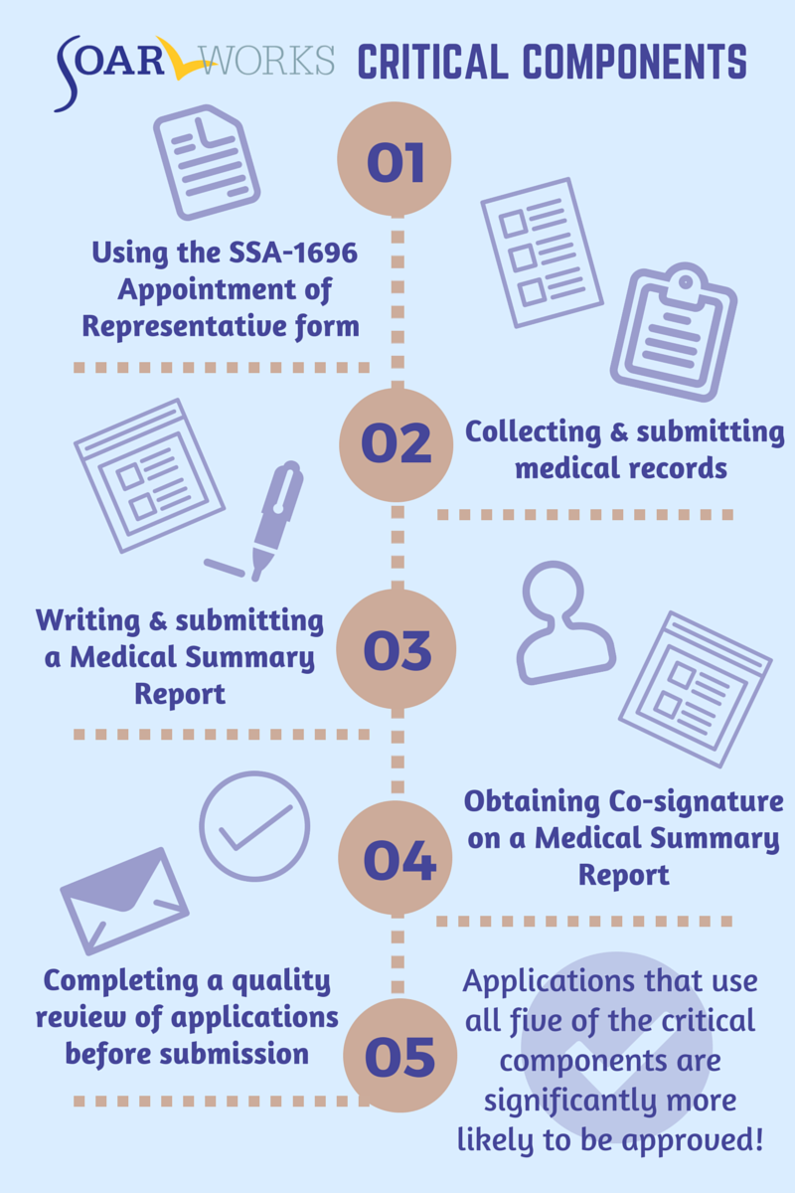


What Makes SOAR Unique?
SOAR-trained case workers are the heroes!
Notes:
At this point, you might be asking yourself, what is the real difference between an individual applying for SSI/SSDI on their own or having assistance from someone trained in the SOAR process. After a person completes the online training, if you stick with these essential components, you’ll be able to provide a targeted, high-quality SSI application to SSA.
Using the Appointment of Rep form allows the case manager to receive copies of all notices mailed to the applicant and to communicate directly with SSA and DDS to provide additional information needed.
DDS examiners must base their determinations on the medical and other evidence available. In order to provide SSA/DDS with sufficient medical evidence of the applicant's disability, SOAR case managers collect and submit medical records as part of the SSI application when possible. This ensures that SSA and DDS receive the information that they need to make a decision.
And 4. Writing a medical summary report (and having it co-signed by the applicants medical provider) or writing a functional report and personal observation. These documents basically refer to a collection of information gathered in collaboration with the parent/caregiver, and submitted to SSA as part of the SOAR application packet. The goal is to provide a supplemental, comprehensive summary of the applicant’s medical treatment and educational history and describes any impairments that stem from psychiatric or medical conditions and affect their ability to function at home, school, and in the community.
5. SOAR strives for complete and high-quality applications. Our mantra: "Get it right the first time!"

Slide 25

Overview of the SOAR Online Course
The techniques taught in this online course can improve the quality and completeness of any application for SSI/SSDI
Register at http://soarworks.prainc.com
20 hours to complete, 20 CEU’s
7 classes (from SOAR 101 to work incentives!)
Submit a practice case to the SOAR Technical Assistance (TA) center for review
Cohort model – why it’s important!
Notes:
The SOAR online course fully prepares providers to learn all of the elements of a complete SSI application including the use of the 5 critical components. The training is standardized, free, web-based, and self-guided.
7 classes, 6 documents to upload for practice case
Video interviews, medical records, and progress notes provide the information needed to complete five SSA forms and write a Medical Summary Report (MSR) for the applicant.
20 CEU’s
In addition to Classes and Articles is a Practicum- Submission of a practice case
This practice case provides an opportunity for case managers to apply what they have learned by completing an SSI/SSDI application packet for a fictional applicant using SOAR techniques.
Cohort - Point out expectations to complete course within timeline so group progresses at similar pace. If you request a cohort, you also have the added benefit of a SOAR lead supporting your group from start to finish.

Slide 26
SOAR Leadership Academy
Details: | Topics Covered Include:
To become a local lead, apply for and attend Leadership Academy! Contact your State Leads for the application. After it’s reviewed, a recommendation is presented to SOAR -Policy Research Associates. | Creating and leading a local steering committee Facilitating effective meetings Supporting quality SOAR applications in your community
Academy lasts 3 days and is held 3 - 4 times a year in various states. | Funding and sustaining SOAR in your community
Must successfully complete the SOAR Online Course prior to attending | Working with special populations and considerations – Veterans, Children, Justice Involved, American Indians and Alaska Natives
Notes:
The SOAR Leadership Academy is a three-day training program presented by the SAMHSA SOAR Technical Assistance (TA) Center designed to prepare individuals to serve as Local Leads within their communities, guide the SOAR initiative, and support individuals who complete the SOAR Online Course.
Washington has two fully funded slots and happens to be hosting one of the leadership academies this year on September 10th -12th. If you live further than 50 miles away from downtown Seattle, SAMHSA pays for lodging and per-diem.

Slide 27
SOAR Local Leads
How does a SOAR Local Lead help implement their state’s SOAR Action Plan?
  Introducing SOAR to their communities
  Support staff/providers that assist disabled individuals with SSI applications
  Holding steering committee meetings
  Co-facilitating SOAR Online Course training cohorts
  Conducting half-day SOAR Online Course review sessions
  Mentoring individuals who complete the SOAR Online Course
  Reporting outcomes in OAT
Notes:
A local lead helps to implement their State’s SOAR action plan by introducing the SOAR initiative to their community, support staff/providers that assist disabled individuals with SSI applications, holding steering committee meeting, co-facilitating SOAR Online Course training cohorts or half-day review sessions, mentoring those who complete the Online Course and finally, reporting outcomes in OAT.

Slide 28




OAT
The SOAR Online Application Tracking (OAT) program is a secure web-based system that allows SOAR case managers to easily track their SOAR SSI/SSDI applications.
Tracking outcomes is an essential piece of funding and sustainability efforts.
Online
Application
Tracking
Web Based
User Friendly
HIPPA Compliant
Free
Notes:
SOAR provides an online application tracking database to track SOAR assisted applications and decisions from initial app through each appeal (when necessary). It takes 5 minutes or less to enter the information needed for each application. By keeping track of approvals, demographic information, and where technical support is needed, SOAR continues to be able to report their outcomes and remain sustainable.
OAT offers role based filters such as by county, agency lead and by user (caseworkers).

Slide 29
Questions & Answers
Notes:
Handouts for SOAR Online Training and the VA data

