Slide 1
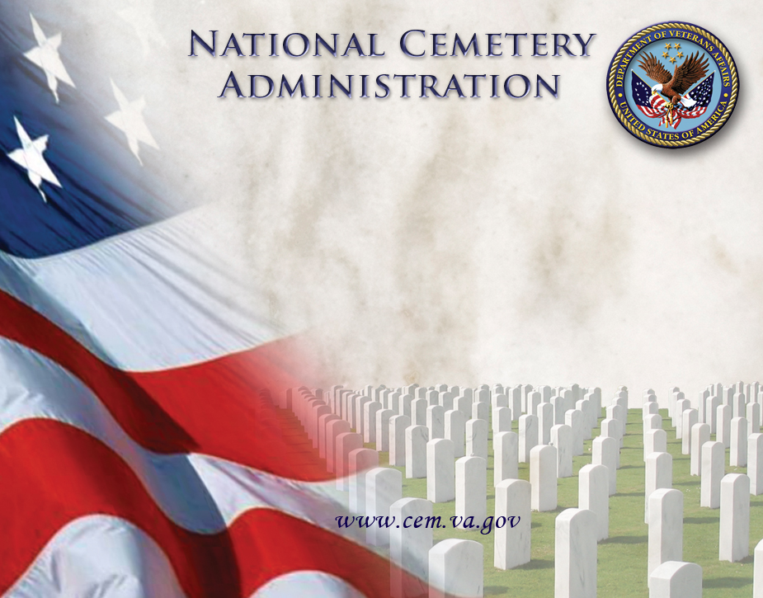
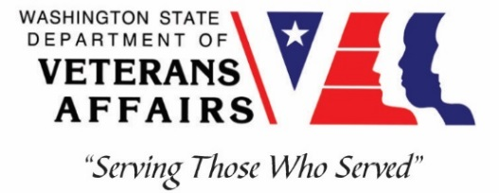
Washington Department of
Veterans Affairs
Veterans Cemetery, Medical Lake
Veterans Burial Benefits
Serving Those Who Served
4th Annual Conference
Rudy Lopez
Cemetery Director
Jul 17, 2019

Slide 2
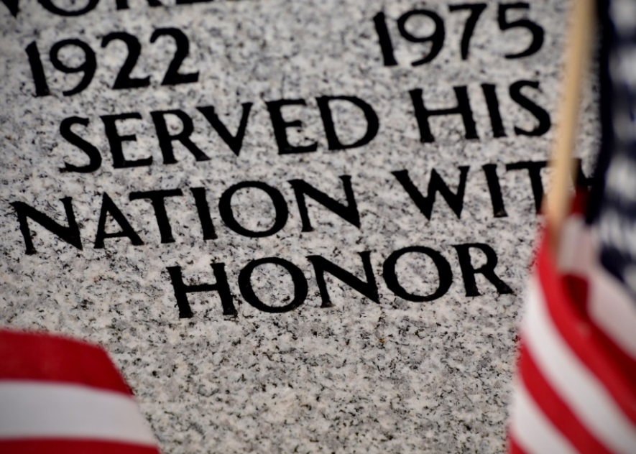
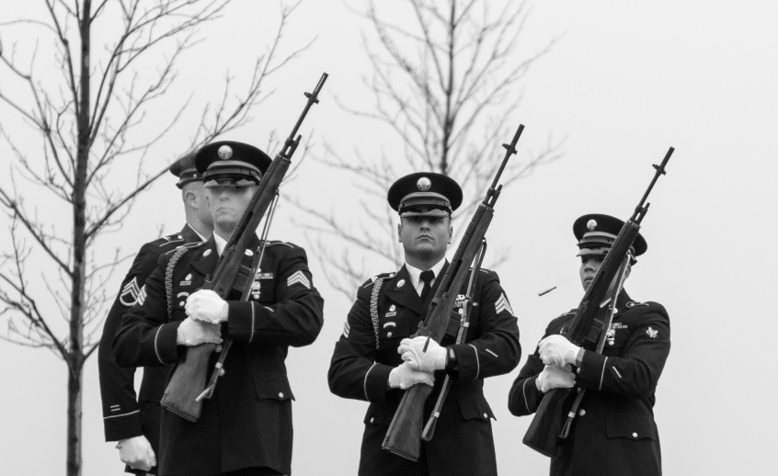
Overview
NCA Memorial Program Overview
DVA Cemetery Program
Memorial Benefits
Resources

Slide 3
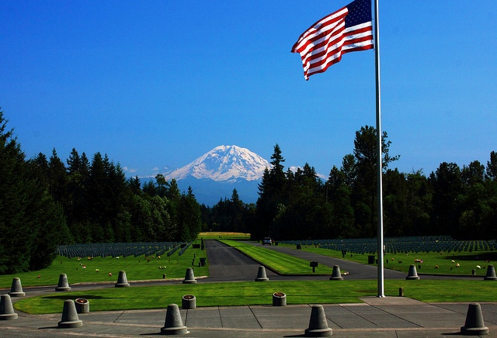
US Department of Veterans Affairs
Veterans Health Administration
Veterans Benefits Administration
National Cemetery Administration
www.VA.GOV
www.CEM.VA.GOV
Notes:
Second largest federal department
Department of Defense
2) Department of Veterans Affairs
3) Department of Homeland Security
4) Department of Justice
5) Department of the Treasury
6) Department of Agriculture
7) Department of the Interior
8) Department of Health & Human Svcs.
9) Department of Transportation
10) Department of Commerce
11) Department of State
12) Environmental Protection Agency
13) Department of Labor
14) Department of Energy
15) Department of Housing & Urban Dev.
16) Department of Education
Department of Veterans Affairs (VA)
The VA manages and administers aid to veterans and their family members. In addition to 100,000 medical specialists, the VA also employs more than 125,000 support personnel at more than 1,000 facilities, including 163 hospitals, nationwide.

Slide 4
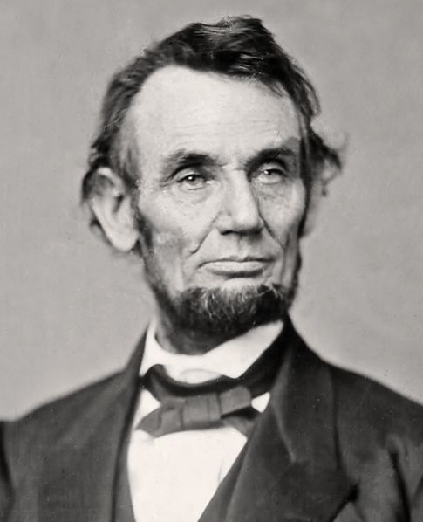
NCA History, Mission, & Vision
History
  Omnibus bill of 1862 authorized President Lincoln to purchase land for National Cemeteries
  1862, fourteen cemeteries established
  Previously soldiers buried where they fell
Mission: Honor veterans & families with final resting places in national shrines & lasting tributes that commemorate their service & sacrifice to our nation
Vision: To be the model of excellence for burial & memorial benefits for our nation’s veterans and their families
Priorities: Preserving Veterans’ legacy, providing access, partnering to serve

Slide 5
NCA Responsibilities
Provide Burial Space for Veterans and Eligible family members, and maintain national cemeteries as national shrines
Administer Federal Grants Program for capital construction and subsequent development of state and tribal Cemeteries
Furnish headstones, markers and medallions for graves of Veterans around the world
Administer Presidential Memorial Certificate program
Administer First Notice of Death program

Slide 6
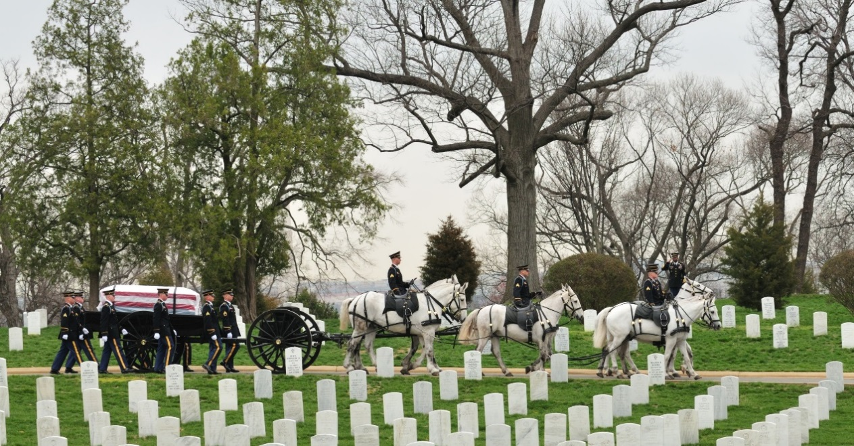
Veterans Cemeteries
136 National
Cemeteries
40 Army
  Arlington*
14 Interior
26 ABMC
112 State & Tribal Veteran Cemeteries (11 tribal) over 39,000 interments in 2018
Perpetual Care 4.7M veterans & family members in over 3.74M gravesites
Notes:
Program History and Background
The federal government’s system of national cemeteries was first established during the Civil War. The Army operated most of the cemeteries until 1973 when they were transferred to the U.S. Department of Veterans Affairs (VA). Arlington National Cemetery is still operated by the Department of the Army. The National Park Service operates several historical national cemeteries such as Gettysburg and Vicksburg. An independent agency, the American Battle Monuments Commission, maintains cemeteries overseas for the dead of World War I and World War II. States have operated Veterans cemeteries since the War with Mexico.
On July 17, 1862 Congress enacted legislation that authorized the President to purchase "cemetery grounds" to be used as national cemeteries "for soldiers who shall have died in the service of the country." Fourteen cemeteries were established that first year, including one in the sleepy Maryland town of Sharpsburg where 4,476 Union soldiers were laid to rest after the one day of terrible slaughter that was the Battle of Antietam. (By way of comparison, approximately 3,000 Americans, British and Canadians died on June 6, 1944, in the invasion of Normandy). 12 of those initial 14 are in the care of the VA.
In 1973, Public Law 93-43 authorized the transfer of 82 national cemeteries from the Department of the Army to the Veterans Administration, now the Department of Veterans Affairs (VA).
On Nov. 11, 1998, the President signed the Veterans Programs Enhancement Act of 1998 changing the name of the National Cemetery System (NCS) to the National Cemetery Administration (NCA).
Today, there are 151 national cemeteries in all. NCA (VA) administers 135 of them. Two national Cemeteries – Arlington and Soldiers Home – are still administered by the Army.
3.5 million gravesites
More than 350 recipients of the Medal of Honor are buried in VA's national cemeteries.
135 National Cemeteries
1 National burial ground
33 Soldiers’ Lots & Monument Sites in 41 states and Puerto Rico
Represents 21,400 acres, 57% of which are undeveloped coupled with developed open plots can accommodate 5.3 million graves
75 are open to all interments
17 can accommodate cremated remains and family member second interments
41 subsequent interments only
66% of all interments occur at 20 busiest national cemeteries:
Riverside (Calif.); Florida; Calverton, (N.Y.); Fort Snelling (Minn.); Jefferson Barracks (Mo.); Fort Logan (Colo.); Dallas - Ft. Worth (Texas); Fort Sam Houston (Texas); Great Lakes (Mich.); Willamette (Ore.); National Memorial Cemetery of Arizona; Sacramento Valley (Calif.); Abraham Lincoln (Ill.); Ft. Rosecrans / Miramar (Calif.); Tahoma (Wash.); Houston (Texas); Ohio Western Reserve; South Florida; Massachusetts; and Sarasota (Fla.)
VA recently implemented plans for new properties that will increase accessibility to a VA burial option. Two new cemeteries opened in Florida in FY 2016, Tallahassee and Cape Canaveral. Omaha opened in September for a total of three new national cemeteries opened in FY 2016. Western New York and Pike’s Peak, Colorado are planned to open in FY 2019. In addition, VA plans to increase burial access for Veterans by establishing seven more rural national cemeteries in sparsely populated rural locations across the country. NCA is also scheduled to open five Columbaria-only sites in New York, NY; Chicago, IL; Indianapolis, IN, Alameda, CA; and Los Angeles, CA by FY 2021.
VA estimates that 553,000 Veterans in the United States and Puerto Rico died in 2016. Twenty percent of U.S. Veterans chose to be buried in a national or state Veterans cemetery in FY 2016. As new national and state Veterans cemeteries open, this percentage is expected to increase.
Today, there are more than 22 million living Veterans who have earned the honor of burial in a national cemetery .

Slide 8
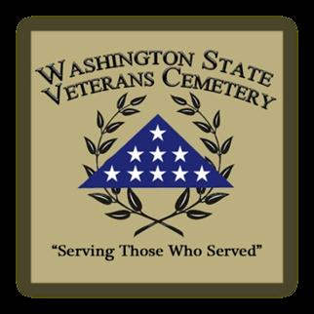
MISSION
“Serving Those Who Served”
“Serving Washington State’s Veterans and Families with Compassionate Care and Service”

Slide 9
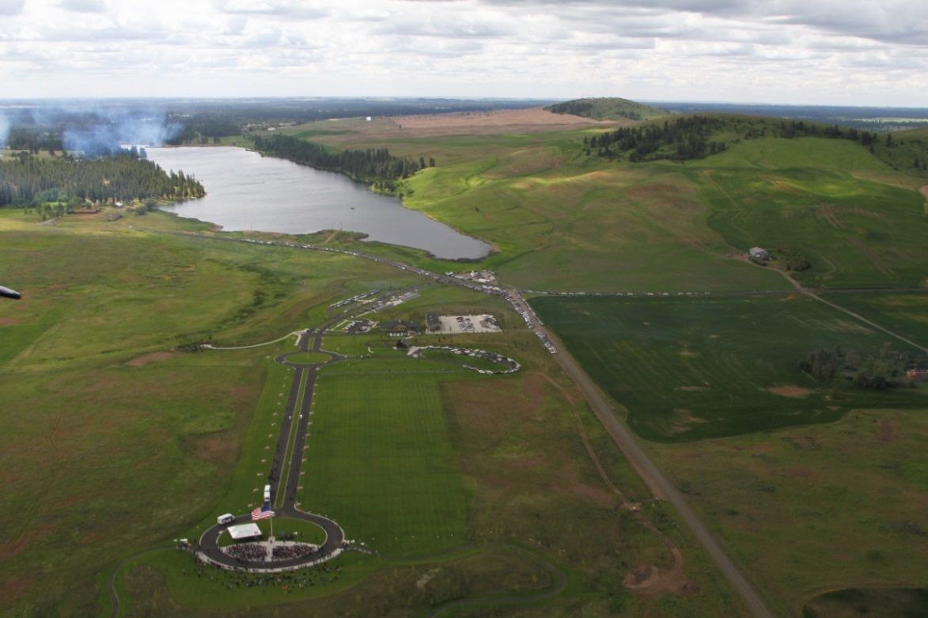
State Veterans Cemetery
Medical Lake
Dedicated May 2010; First Interment Jun 2010
$8.8M Grant – Collaborative Federal VA & WDVA Project
  120 acres
Master Plan – Fed Grants
  Phase I, Complete
  Phase II, $2.3M Complete
  Phase III, Pending
5,500 Interred to Date
  809 families served CY18
    22.5% increase
Future – Expand Access
to Burial Benefit
Notes:
5200 interments through 1 Oct 18

Slide 10
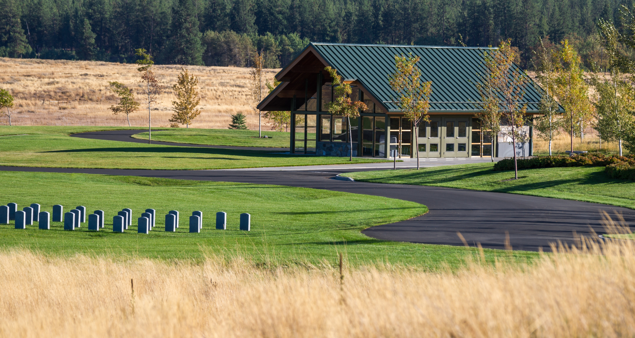

Slide 11
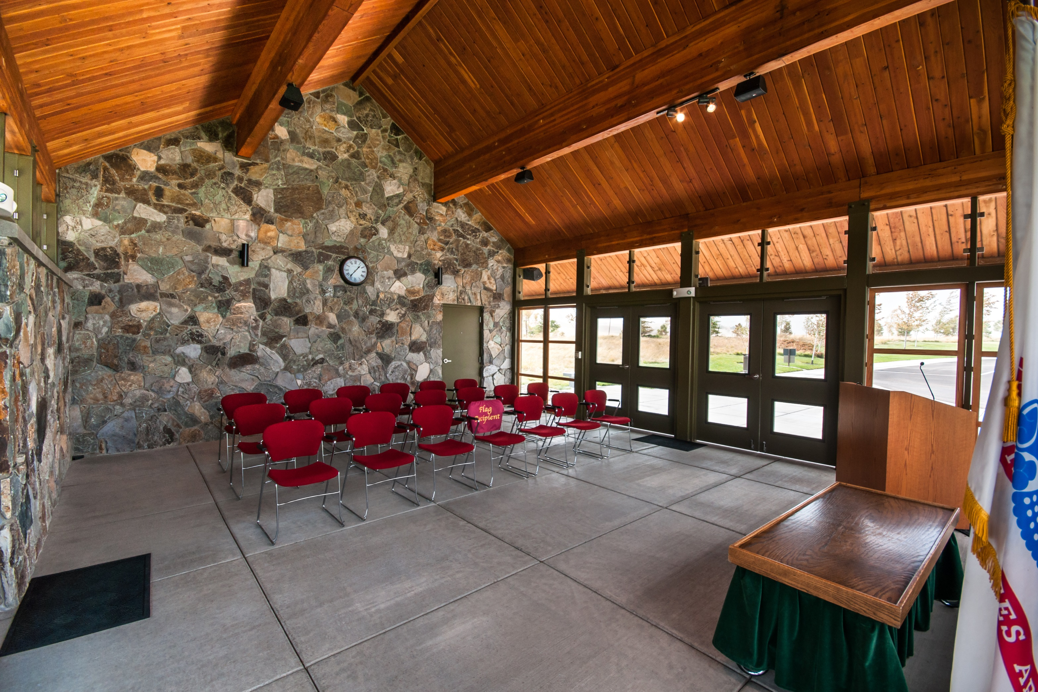

Slide 12

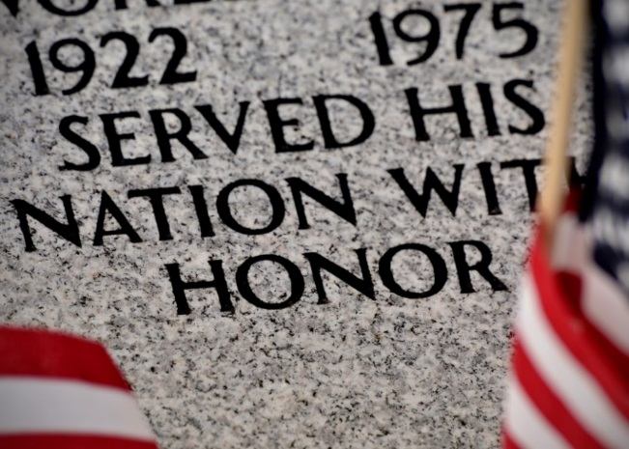
Burial Benefits
Interment Plot
Grave Liner (traditional)
Open & Close Grave
Perpetual Care
Military Honors – PL 106-65 DOD, (Funeral Director Coord)
Headstone, marker or medallion (for vet or private cemetery)
U.S. Burial Flag (FD or US Postal)
Presidential Memorial Certificate
*Urn/Casket, Prep, & Transportation family expenses unless veteran was service connected. Limited funds available via claim, paid out after the fact
Notes:
Since 1973, NCA has furnished more than 13 million headstones and markers. In FY 2016, NCA furnished approximately 353,620 headstones and markers.
NCA provided approximately 689,587 Presidential Memorial Certificates to the loved ones of deceased Veterans in FY 2016.
Department of Defense (DOD) is responsible for providing military funeral honors. "Honoring Those Who Served”.
Upon the family's request, Public Law 106-65 requires that every eligible Veteran receive a military funeral honors ceremony, to include folding and presenting the United States burial flag and the playing of "Taps." The law defines a military funeral honors detail as consisting of two or more uniformed military persons, with at least one being a member of the Veteran's parent service of the armed forces.
DOD program calls for funeral home directors to request military funeral honors on behalf of the Veteran's family. However, the Department of Veterans Affairs National Cemetery Administration cemetery staff can also assist with arranging military funeral honors at VA national cemeteries. Veterans organizations may also assist in providing military funeral honors.
The DOD began the implementation plan for providing military funeral honors for eligible Veterans on Jan. 1, 2000.
A United States flag is provided, at no cost, to drape the casket or accompany the urn of a deceased Veteran who served honorably in the U. S. Armed Forces. It is furnished to honor the memory of a Veteran's military service to his or her country. VA will furnish a burial flag for memorialization for an other than dishonorably discharged:
• Veteran who served during wartime
• Veteran who died on active duty after May 27, 1941
• Veteran who served after January 31, 1955
• Peacetime Veteran who was discharged or released before June 27, 1950
• Certain persons who served in the organized military forces of the Commonwealth of the Philippines while in service of the U.S. Armed forces and who died on or after April 25, 1951
• Certain former members of the Selected Reserves
Who is Eligible to Receive Burial Flag? Generally the flag is given to the next of kin after its use during the funeral service. When there is no next of kin, the VA will furnish the flag to a friend making request for it. For VA National Cemeteries with an Avenue of Flags, families of veterans buried in these facilities may donate the burial flags of their loved ones to be flown on patriotic holidays. The Avenue of Flags is a display of respect for the service performed by our nation’s Veterans, and usually lines the main entrance way of a national cemetery on Memorial Day, Veterans Day or other days of national significance.
Apply using VA Form 27-2008. US Post Offices are primary issuing points for burial flags. Call and confirm with the Post Office in advance. Not all post offices have burial flags on hand. Regional VA offices can also help identify local issuing points.
The law allows us to issue one flag for a Veteran’s funeral. The VA cannot replace lost, destroyed, or stolen burial flags. However, some veterans organizations or community groups may be able to assist with obtaining another flag.
Military funeral honors website is located at https://www.dmdc.osd.mil/mfh/. Questions or comments concerning the DOD military funeral honors program may be sent to:
Office of the Deputy Assistant Secretary of Defense
(Military Community and Family Policy)
4000 Defense Pentagon, Room 5A726
Washington, DC 20380-4000
The Department of Defense (DOD) is responsible for military funeral honors. However, military downsizing during the late 80’s and 90’s resulted in difficulty in providing funeral honors. Consequently, the Veterans of Foreign Wars (VFW) and the American Legion were called upon to assist the DOD in their responsibilities, volunteering the operation of funeral honors for fallen veterans when the DOD could not.
Congress deemed this unsatisfactory in 1999 and enacted a law requiring the military services to provide funeral honors for eligible veterans (“Eligibility for Military Burial”).
If requested, the DOD is obligated to provide an honor guard comprised of at least two military members to conduct funeral honors for eligible veterans. At the very minimum, the honor company is required to perform a ceremony including the folding and presenting of the American flag to the next of kin and the playing of taps.
A minimum of two honor guards to perform at a veteran’s funeral is mandatory by law, but in most cases, the funeral company is comprised of four to seven members, contingent on the abilities of the local honor guard unit, accessible resources, and manpower. Other veterans’ services taking place in the same vicinity on the same day can also affect the honor guard availability.
Taps: Taps is a traditional bugle call sounded at military funerals by an official bugler if available or by electronic means. The honor guard presents a final salute to the deceased veteran during the playing of taps.
Flag Folding: The U.S. flag is carefully taken from the casket and silently folded by the honor guard company. Once folded, the flag resembles a triangle, representative of the three-cornered hats worn by colonial soldiers during the Revolutionary War. The method used during the folding of the flag requires 13 folds that represent the original colonies and once the flag is completely folded no stripes are visible, leaving only the blue and stars.
Flag Presentation: After the flag is folded it is presented to an honor guard member in the same military branch as the deceased veteran who subsequently marches the flag to the next of kin and presents the flag to them. During the member’s presentation to the next of kin, they say, “As a representative of the United States Army (Air Force/Navy/Marine Corps/Coast Guard), it is my high privilege to present you this flag. Let it be a symbol of the grateful appreciation this nation feels for the distinguished service rendered to our country and our flag by your loved one.”
Provided there is no next of kin, the flag is presented to a friend of the deceased.
Pallbearers: If available, family members can request that members of the honor guard function as pallbearers and provide other funeral honors.
Rifle Volley: A rifle volley is a customary tradition in which three volleys of shots are fired in honor of the deceased veteran by members of the honor guard company. Rifle volleys are performed only if the family chooses.
Rifle volleys are fired from rifles and not guns, so they are not gun salutes. Seven or eight members comprise the firing team where each member fires three times.
The three volleys originate from a custom in which battle would temporarily stop for service members to clear their dead from the battlegrounds. When a side had successfully removed their dead, they fired three rifle volleys to signify the continuation of battle.
When the honor guard is finished with the volley, they generally fold three shell-casings into the flag before presenting it to the family.
*Subsidence

Slide 13
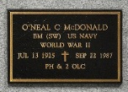
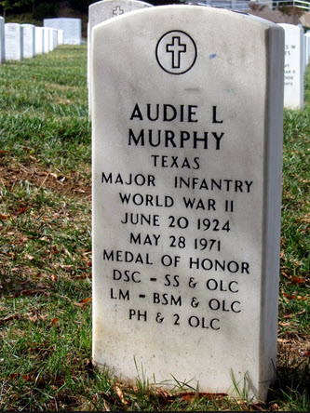
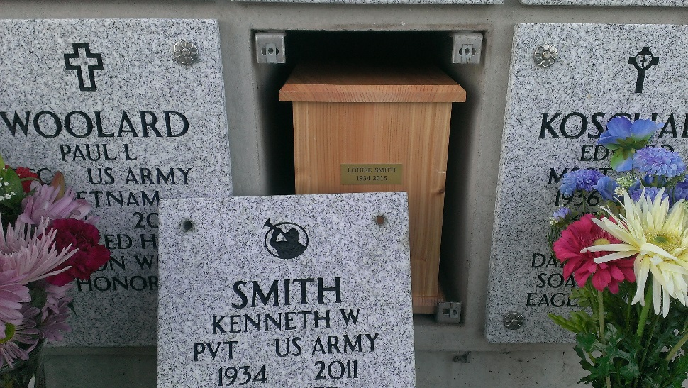
Headstones, Markers
VA Form 40-1330
Bronze
Uprights
Niche Cover
Notes:
Since 1973, NCA has furnished more than 13 million headstones and markers. In FY 2016, NCA furnished approximately 353,620 headstones and markers

Slide 14
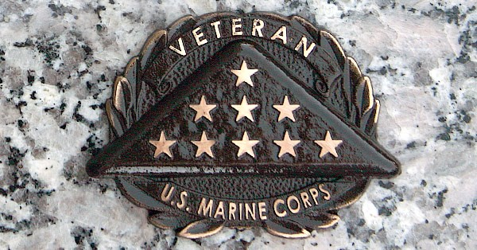
Medallions
In Lieu of Marker
For Privately Purchased Markers in Private Cemeteries
  Small 2” x 1.5”
  Medium 3.75” x 2.8”
  Large 6.75” x 4.75”
VA Form 40-1330M

Slide 15
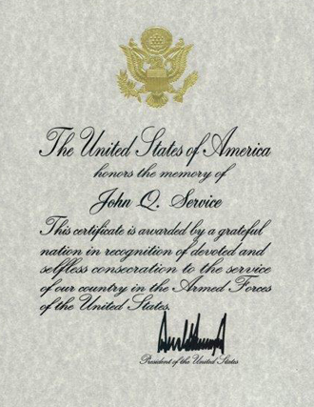
Presidential Memorial Certificate
May request more than one copy
VA Form 40-0247
  DD214 & DC
~16 Week Turnaround
  (202) 632-7300

Slide 16
Burial Eligibility Criteria
38 U.S.C. Section 2402 – burial in a veterans cemetery
Member of U.S. Armed Forces who dies on AD
Any Veteran discharged under qualifying conditions (honorable or general discharge)
National Guard & Reservists with 20 years of qualifying service, entitled to retired pay
Spouses & Minor Children
Discharge Records & Marriage Cert - Required
38 U.S.C. Section 2411 Capital Crimes ~ bar from
benefits for capital crimes w/life sentences
Notes:
All honorably discharged Veterans became eligible for burial in 1873.
Veteran discharged under conditions other than dishonorable with service beginning after Sep 7, 1980 (enlisted) and service after Oct 16, 1981 (Officer) must be for a minimum of 24 continuous months or the full period for which the person was called to active duty (Reservist called to active duty for a limited duration).
Any citizen of the US who during any war in which the US has or may be engaged, served in the Armed Forces of any Government allied with the US during the war, whose last active service was terminated honorably by death or otherwise, and who was a citizen of the US at the time of entry into such service and at the time of death.
Members of the Reserve Component and Reserve Officers‘ Training Corps
Commissioned Officers, National Oceanic and Atmospheric Administration
Public Health Service
WWII Merchant Mariners
Philippine Armed Forces
Spouses and Dependents – even if the veteran is not buried or memorialized in a national cemetery
Parents – Corey Shea Act – Biological or adoptive parents, who died after Oct 13, 2001 and whose death was the result of hostile casualty or training-related injury and
Who is interred in a national cemetery, in a gravesite with available space for subsequent interment and,
At the time of the parent’s death, had no spouse, surviving spouse, or child who is buried or who upon death may be eligibile for burial in a national cemetery
Under 38 U.S.C. § 2411 Interment or memorialization in a VA national cemetery or Arlington National Cemetery is prohibited if a person is convicted of a Federal or State capital crime for which sentence of imprisonment for life or the death penalty may be imposed and the conviction is final. Federally funded State veteran cemeteries must adhere to this law. This prohibition is also extended to furnishing a Presidential Memorial Certificate, a burial flag and a headstone or marker.
Persons convicted of certain sex offenses. Under 38 U.S.C. § 2411, interment or memorialization in a VA national cemetery or in Arlington National Cemetery is prohibited if a person is convicted of a Tier III sex offense, who is sentenced to a minimum of life imprisonment and whose conviction is final. Federally funded State and Tribal organization Veterans Cemeteries must also adhere to this law. This prohibition also applies to Presidential Memorial Certificates, burial flag, and headstone and marker benefits.

Slide 17
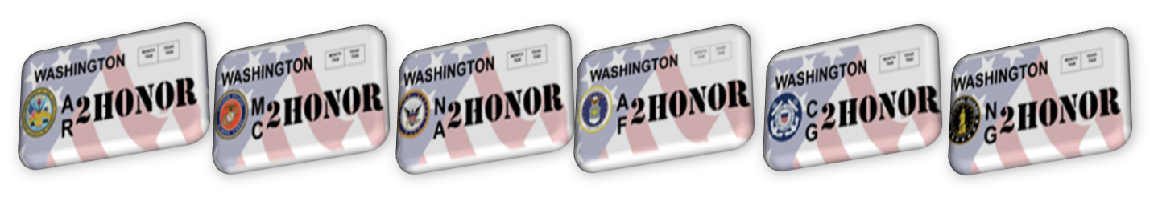
Veteran Cemetery FY18 Funding
General Fund State $100,000 - 15%
VA Plot Allowance $368,983 – (no fee to Vets)
  Reimbursement $780 to $150
Family Member Interment $52,500 – ($300)
AFLP $536K ($28 revenue per license annually)
  @ State Licensing Offices: multiple vehicles, fam members authorized, tax deductible donation

Slide 18
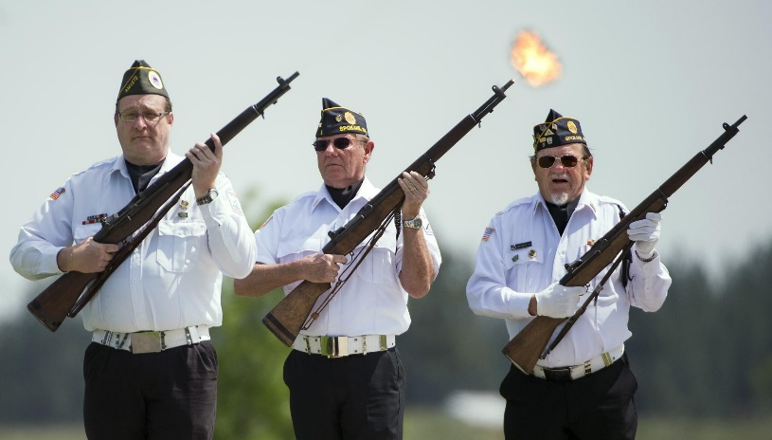
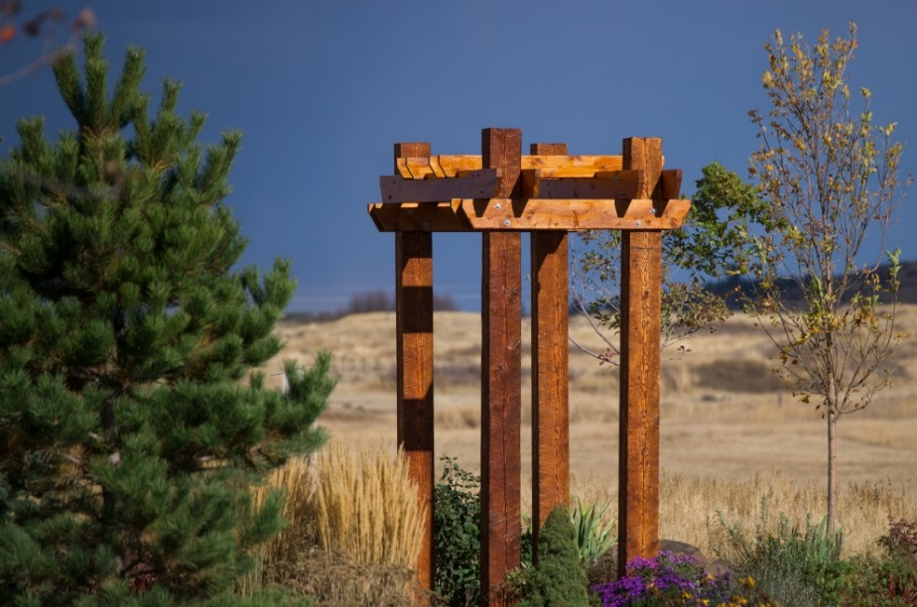
Volunteers
100 Volunteers donated 3,000 service hours in CY18
Service Projects
Donations

Slide 19
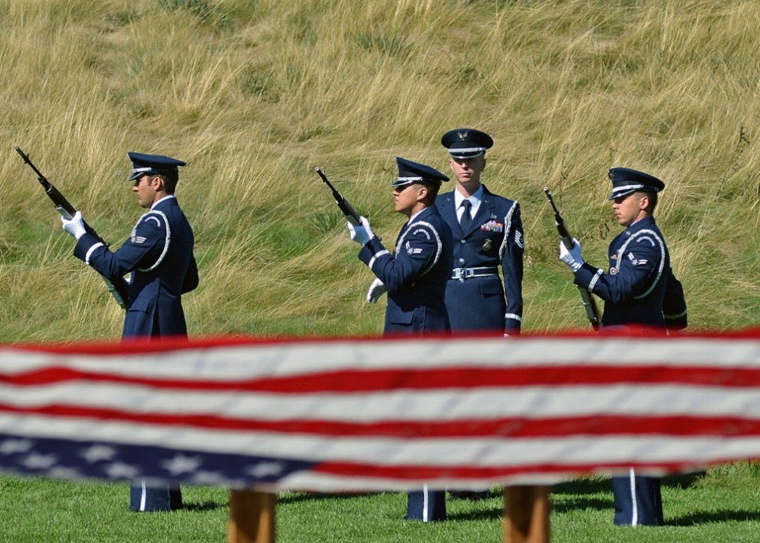
VA Burial Assistance / Resources
VA Burial Allowance - $300 to $2K for burial expenses if vet has service connected disability
VA Plot Allowance – $780 for privately purchased plot
Scheduling:
  National Cemetery
  866-900-6417
  www.cem/va.gov
  Medical Lake
  509-299-6280
Notes:
Human remains that have not been disposed—Rules.
(1) Whenever any human remains shall have been in the lawful possession of any person, firm, corporation, or association for a period of ninety days or more, and the relatives of, or persons interested in, the deceased person shall fail, neglect, or refuse to direct the disposition, the human remains may be disposed of by the person, firm, corporation, or association having such lawful possession thereof, under and in accordance with rules adopted by the funeral and cemetery board, not inconsistent with any statute of the state of Washington or rule adopted by the state board of health.
(2)(a) The department of veterans affairs may certify that the deceased person to whom subsection (1) of this section applies was a veteran or the dependent of a veteran eligible for interment at a federal or state veterans' cemetery.
(b) Upon certification of eligible veteran or dependent of a veteran status under (a) of this subsection, the person, firm, corporation, or association in possession of the veteran's or veteran's dependent's remains shall transfer the custody and control of the remains to the department of veterans affairs.
(c) The transfer of human remains under (b) of this subsection does not create:
(i) A private right of action against the state or its officers and employees or instrumentalities, or against any person, firm, corporation, or association transferring the remains; or
(ii) Liability on behalf of the state, the state's officers, employees, or instrumentalities; or on behalf of the person, firm, corporation, or association transferring the remains.

Slide 20
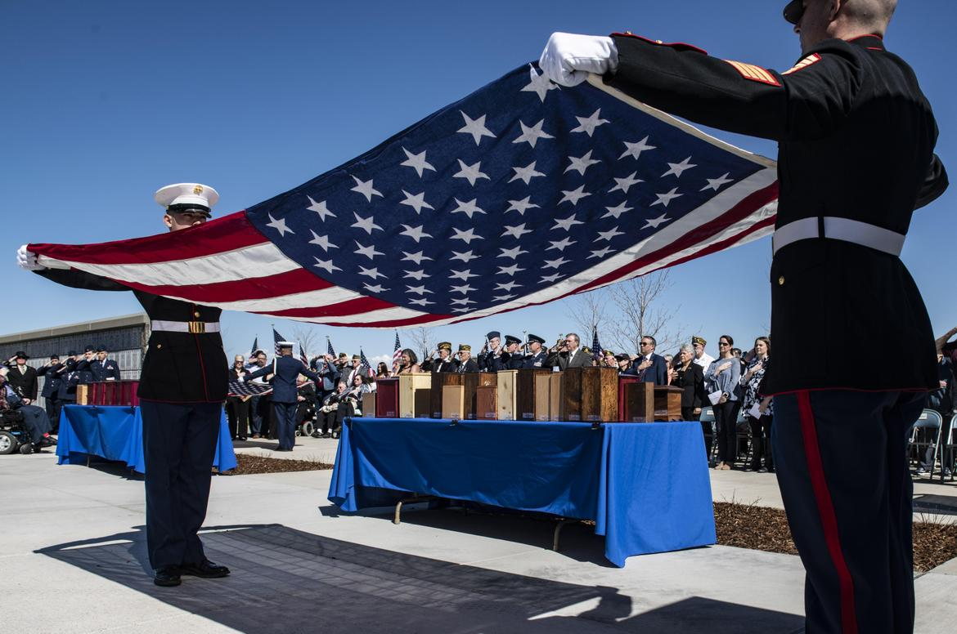
Indigent Veteran Interments
RCW 68.50.230 *Human Remains not Disposed – DVA certifies vet
RCW 70.58.107 Vital Records, no fee for VA benefits
RCW 73.08.070 County, Indigent Veteran Burials
RCW 73.08.010 County Veteran Assistance – needs based

Slide 21
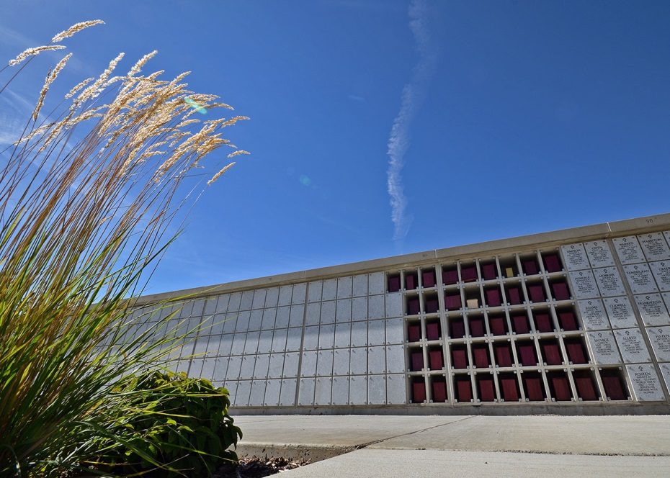
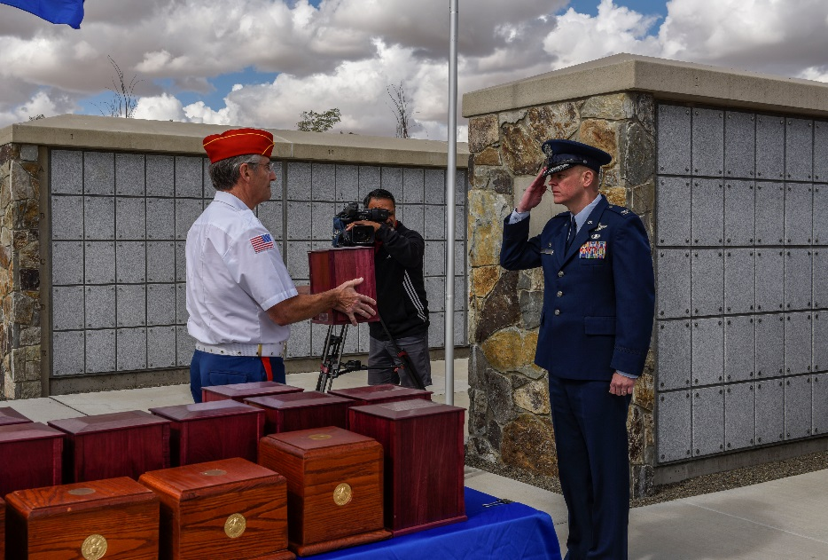
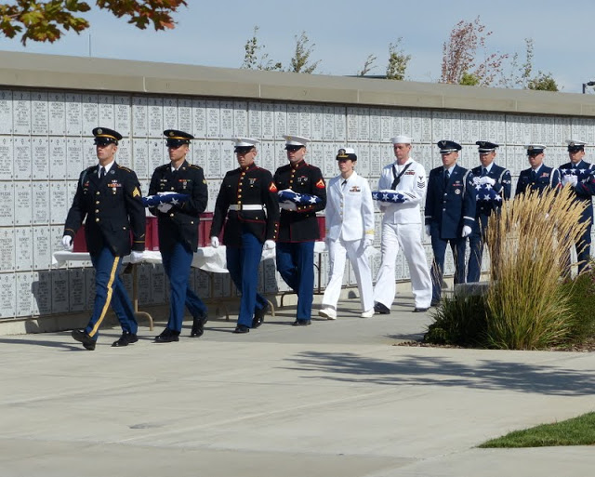
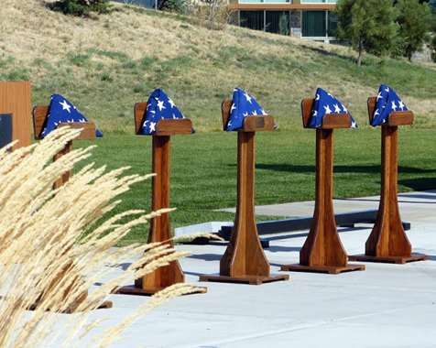
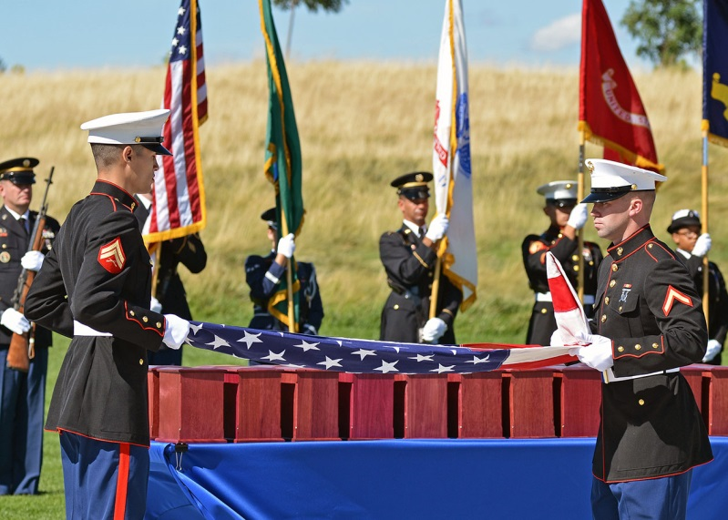
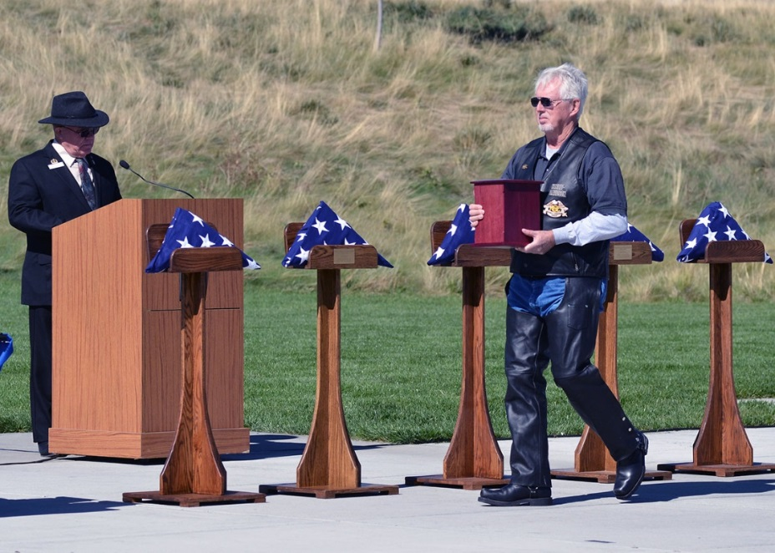
Unclaimed Interment Ceremony

Slide 22
Death Notifications
VA Office of Survivors Assistance 800-827-1000
*Survivor Benefits, Claim Status, Tax docs,
Social Security Admin 800-772-1213 ($255)
Mil Retiree DFAS 800-321-1080 (pay) or MilPers
Casualty Assistance – Mil One Source 800-342-9647
  JBLM (Army CAO) 253-966-5890 or 253-967-0015
  JBLM (AF CAO) 253-982-3821
  NB Kitsap (Navy/Marines CACO) 360-315-3274
  FAFB (AF CAO) 509-247-4488
Notes:
By calling 1-800-827-1000 you can:
Check on the status of your claim
Obtain tax documentation
Notify VBA of the death of a veteran or a benefit recipient
Request information on burial and mortuary benefits
Learn about benefits available to surviving family members
Much, much more
To obtain copy of your loved one's service record (DD-214) please contact the National Archives
Casualty Assistance Office (Fairchild) 247-4488 Command Post, 247-4051 after hours
CAR will notify DFAS
Deceased Retiree’s information
Retiree’s full name
Retiree’s Social Security Number
Date and Place of Death
Cause of Death (in layman’s terms)
NOK Name, Relationship and contact information
Funeral Date, Place and Time (if known)
Documents for settling estate
Death Certificate or DD Form 1300, Report of Casualty (for retiree deaths occurring w/in 120 days of retirement
DD Form 214 or other discharge document
Retirement Order
Birth Certificate
Marriage Certificate
Adoption Papers
Legal Name Change if applicable
Divorce Papers or death certificate of former spouse(s)
Social Security Numbers of applicable family members
Custodian or Guardian documents
Will
Medical Statement of incapacitation
Income Tax Records
Bank Account or Credit Union Account Numbers
Commercial Insurance Policies
Stocks and Bonds
Titles of Ownership
Mil ID Card
Driver’s License

Slide 23
VA Burial Assistance / Resources
Credentialed Veteran Service Officers
  VA Hospital Bldg 6A, 4815 Assembly St 509-434-7750
  Vet Center, 13109 E Mirabeau Pkwy 509-444-8387 https://www.vetcenter.va.gov/
  Veteran Service Organizations (VFW, AmLegion, DAV)
  WDVA Service Center 800-562-2308 benefits@dva.wa.gov
  Spokane County Veterans Services (WDVA affiliate) 1117 N Evergreen Rd, Suite 2 - 509-477-3690 https://www.spokanecounty.org/1122/Veteran-Services
  *Manages County Veterans Assistance Fund
Notes:
VA Health Care System
Lakewood:VA Puget Sound Health Care System - American Lake Division
Seattle:VA Puget Sound Health Care System
Seattle:VA Puget Sound Health Care System - Seattle Division
VA Medical Center
Spokane:Mann-Grandstaff VA Medical Center
Vancouver:VA Portland Health Care System - Vancouver Campus
Walla Walla:Jonathan M. Wainwright Memorial VA Medical Center
Sp Co Vet Service Center
Nichols, Cathrene Director 477-3690
Drake, Heather Operations Manager 509.477.3690
Wall, Adrian Veteran Services Officer 509.477.3690
Blackburn, Eric Veteran Services Officer 509-477-3690
McGuire, Stephen Veteran Service Officer 509-477-3690
Becker, Claudette Veteran Service Officer 509-477-3690
Rushton, April Office Assistant 509.477.3690
Tucker, Marvin Staff Assistant 509-477-3690

Slide 24
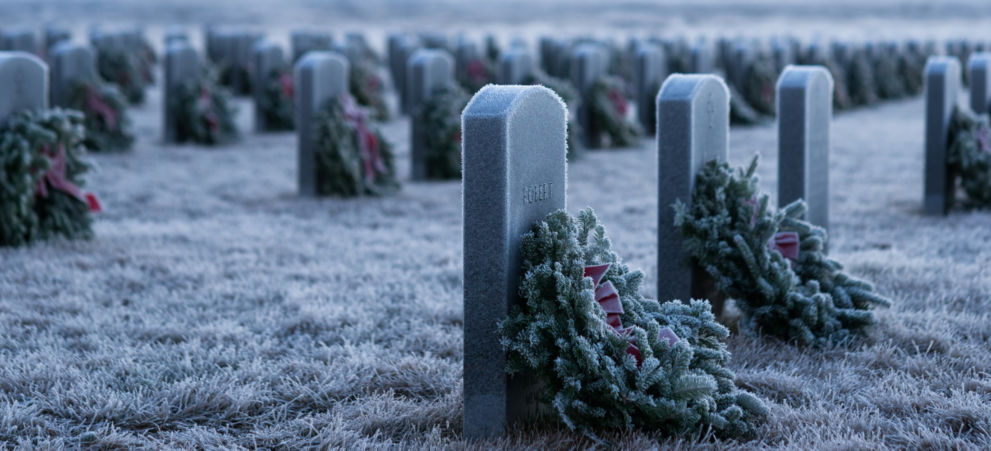
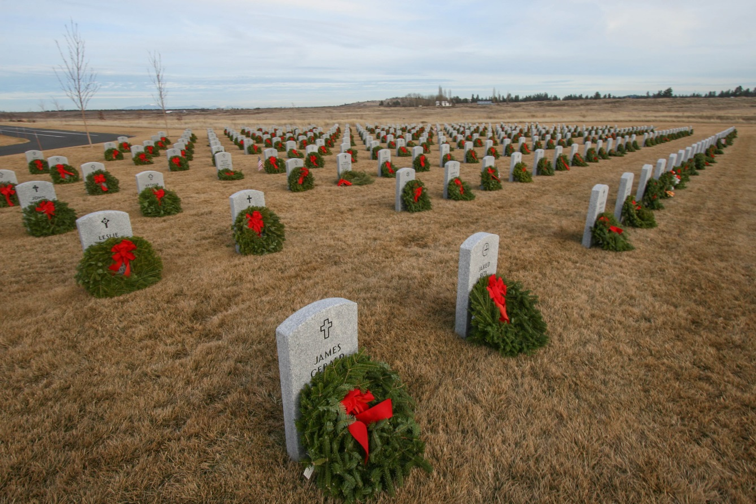
Wreaths Across America
Mission: Remember, Honor, Teach
Saturday Dec 15 (Tahoma 9am; ML 12noon)

Slide 25
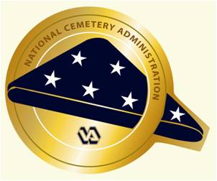
Contact Information
State Veterans Cemetery, Medical Lake
  21702 W Espanola Road, Medical Lake WA 99022
  509-299-6280 cemetery@dva.wa.gov
Benefits
800-562-2308 benefits@dva.wa.gov
http://www.dva.wa.gov/about-wdva/brochures-and-newsletters
Tahoma National Cemetery
  18600 SE 240th Street, Kent WA 98042
  425-413-9614
  www.cem.va.gov/cems/nchp/Tahoma.asp

Slide 26
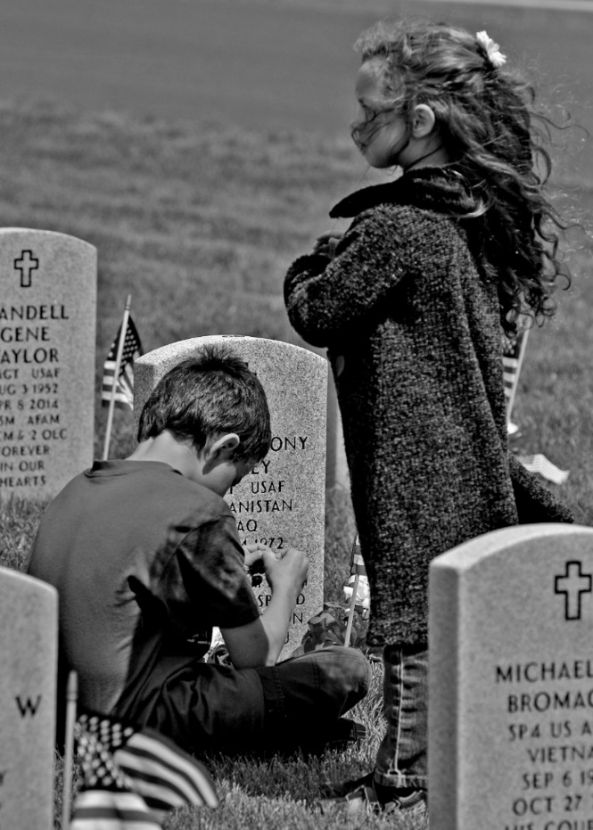
Keeping the Promise, Together

Slide 27
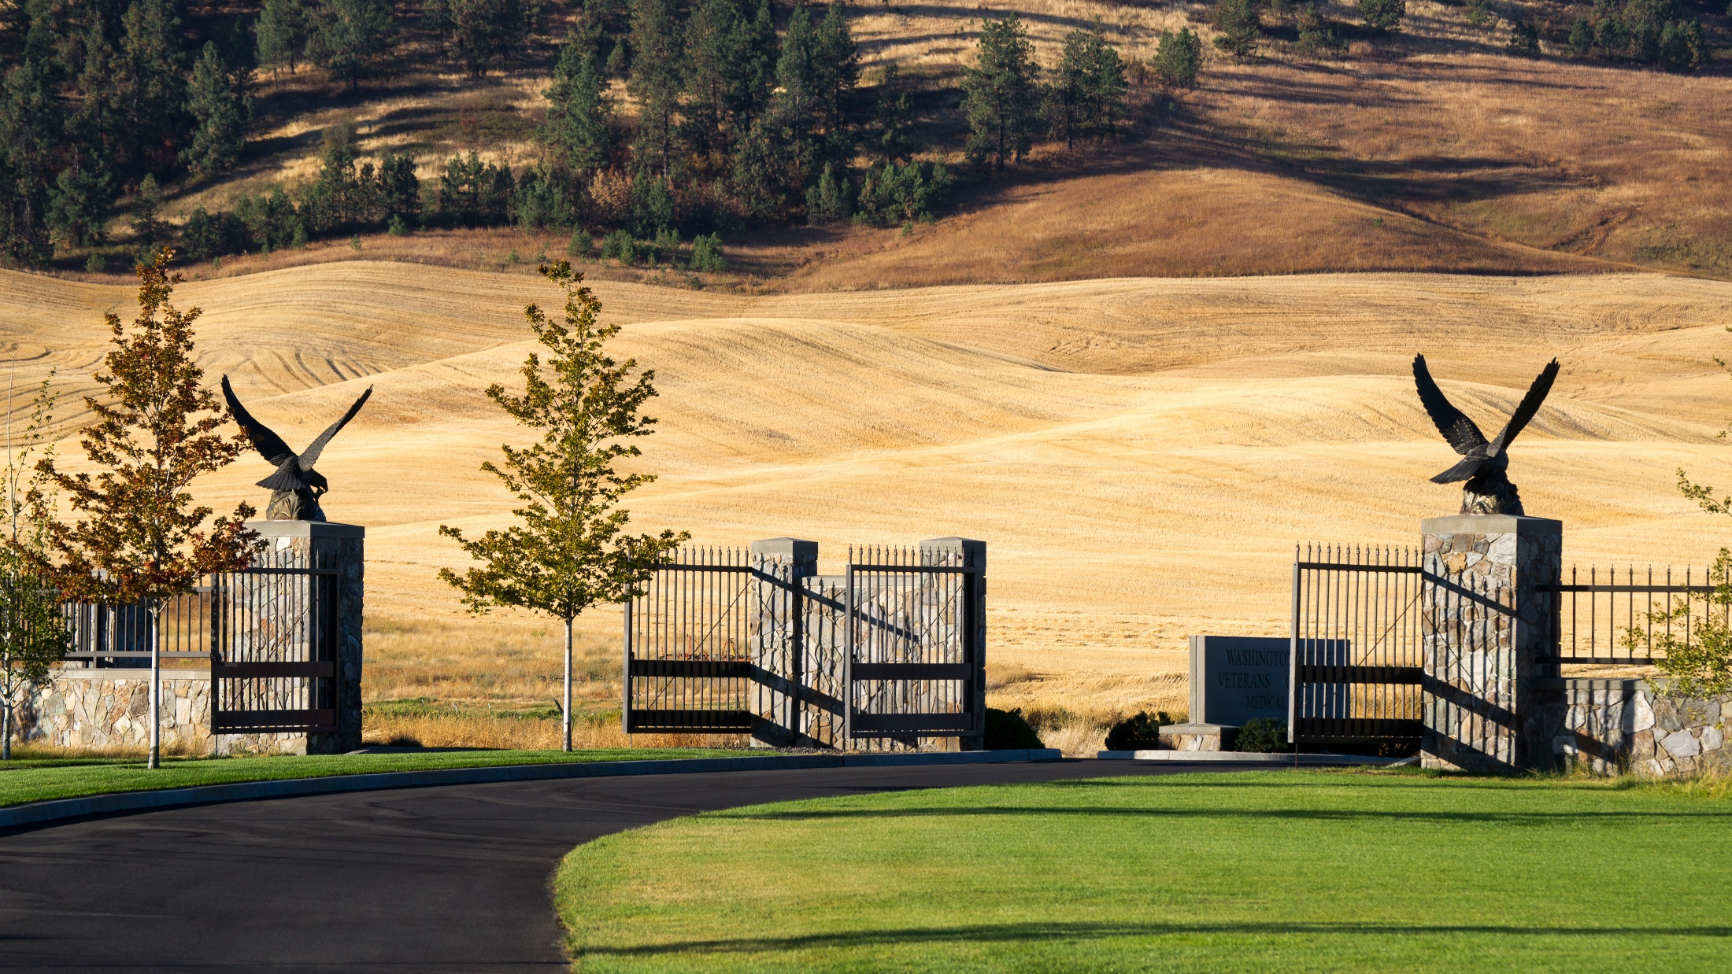
Questions

