Slide 1
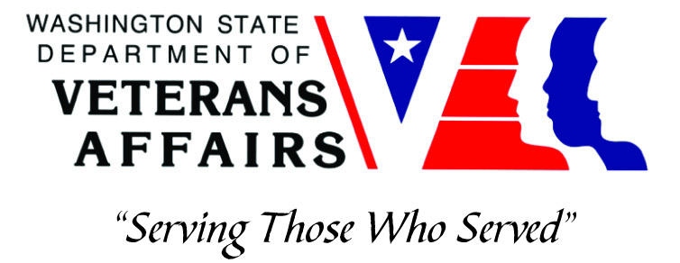
County and Tribal Veteran Service Officers
Steven J. Gill
Veteran Services Administrator and Tribal Liaison
360-725-2235
steveng@dva.wa.gov
July 2019

Slide 2
Veteran Service Officers
Types of Veteran Service Officers:
Veteran Service Organizations
Post/Chapter Service Officers
Department/State-Level Service Officers
National Service Officers
County or Tribal Governments
Employed by a County or Tribal government
Must be paid employees at least 1,000 hours annually (CFR Title 38, Chapter 1, Part 14, §14.629)
State Veteran Agencies
Employed by State Veteran Agencies
Accredited Veteran Service Officers of other organizations
May extend accreditation to County or Tribal Veteran Service Officers through agreements
*Accreditation of Claims Agents and Attorneys is separate (CFR Title 38, Chapter 1, Part 14, §14.629)

Slide 3
Strategies For Collaboration
Washington State Department of Veterans Affairs:
County and Tribal Veteran Service Officers
Must be employed by County or Tribal governments
May be accredited by Washington State Department of Veterans Affairs through a memorandum of agreement (MOA) in which WDVA provides:
Training
Accreditation
Tracking and reporting of outcomes (ROI)
Representation of VA Appeals at Seattle VA Regional Office
Counties and Tribes with MOAs or VSO contracts:
Counties: Chelan, Clark*, Douglas, Grant, King*, Klickitat, Lewis, Okanogan, Skagit*, Snohomish, Spokane, Whatcom
(*contracted to a veteran service organization)
Tribes: Suquamish Tribe, Tulalip Tribes, Yakama Nation

Slide 4
VA Compensation & Pension - FFY17
WA State Average: 25.4%
National Average: 24.1%
Above National Avg. Below National Avg.
Whatcom
23.1%
San Juan 12.7%
Skagit
22.6%
Okanogan
25.0%
Ferry
23.4%
Pend
Oreille
24.8%
Island 31.4%
Stevens
30.3%
Clallam 23.6%
Snohomish
20.2%
Jefferson 19.7%
Chelan
20.6%
Douglas
17.3%
Kitsap
Kitsap 33.5%
King
18.4%
Lincoln
18.0%
Spokane
26.4%
Bremerton
Seattle
King
Grays Harbor
22.9%
Mason
25.8%
Tacoma
Kittitas
19.3%
Grant
21.9%
Olympia
Pierce
33.2%
Adams
21.4%
Whitman
18.3%
Thurston
35.8%
Pierce
Thurston
Pacific
19,0%
Lewis
22.8%
Franklin
26.1%
Garfield
28.8%
Yakima
21.3%
Benton
22.1%
Columbia
18.8%
Cowlitz
23.4%
Skamania
13.1%
Walla Walla
26.9%
Asotin
21.5%
Wahkiakum
20.2%
Clark
23.7%
Klickitat 26.3%
Source: VA National Center for Veterans Analysis and Statistics, www.va.gov/vetdata

