Slide 1
Okanogan County Veterans Service Office
County Veteran Service Officer Program
Presented by:
Eric Fritts

Slide 2
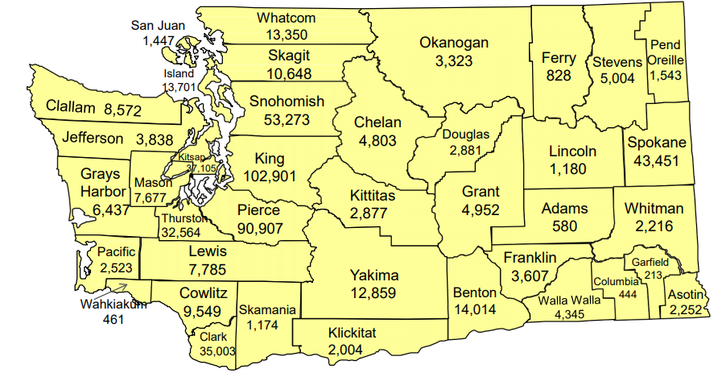
County Veteran Service Officer Program
County Veteran Population
Washington State Veteran Population by County in 2018
Total State Veteran Population is 552,291

Slide 3
County Veteran Service Officer Program
Show Me The Money
RCW 73.08.010
County veterans' assistance programs for indigent veterans and families—Requirements.
(1) For the relief of indigent veterans, their families, and the families of deceased indigent veterans, the legislative authority of each county shall establish a veterans' assistance program to address the needs of local indigent veterans and their families. The county legislative authority shall consult with and solicit recommendations from the veterans' advisory board established under RCW 73.08.035 to determine the appropriate services needed for local indigent veterans. Veterans' assistance programs shall be funded, at least in part, by the veterans' assistance fund created under the authority of RCW 73.08.080.
(2) The county legislative authority may authorize other entities to administer a veterans' assistance program or programs through grants, contracts, or interlocal agreements. If the county legislative authority authorizes another entity to administer a veterans' assistance program or programs, the terms of the grant, contract, or interlocal agreement must, for each program, specify:
(a) The details of the program;
(b) The responsibilities of all parties;
(c) The duration of the program;
(d) The costs and sources of funding;
(e) Any insurance or bond requirements;
(f) The format and frequency of progress and final reports; and
(g) Any other information deemed necessary or appropriate by either party.
(3) If the county legislative authority authorizes another entity to administer a veterans' assistance program or programs, the authorized entity should, to the extent feasible and consistent with this chapter, ensure that a local branch of a nationally recognized veterans' service organization is the initial point of contact for a veteran or family member seeking assistance.
(4) Nothing in this section shall prohibit or be construed as prohibiting a county from authorizing the continued operation of a veterans' relief or assistance program or programs existing on January 1, 2005, if the authorizing legislative authority:
(a) Solicits advice from the veterans' advisory board established in RCW 73.08.035; and
(b) Satisfies the grant, contractual, or interlocal agreement requirements of subsection (2) of this section.
Notes:
Veteran’s Service Board outlines requirements and the County Commissioners approve exceptions

Slide 4
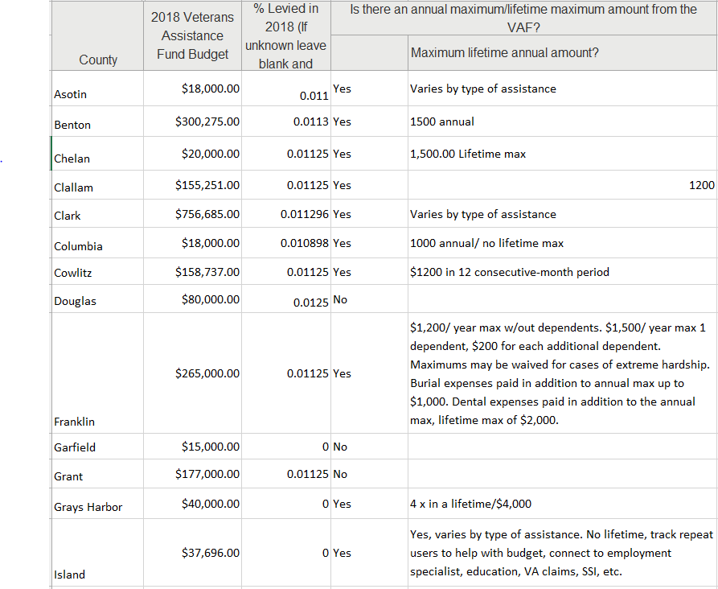
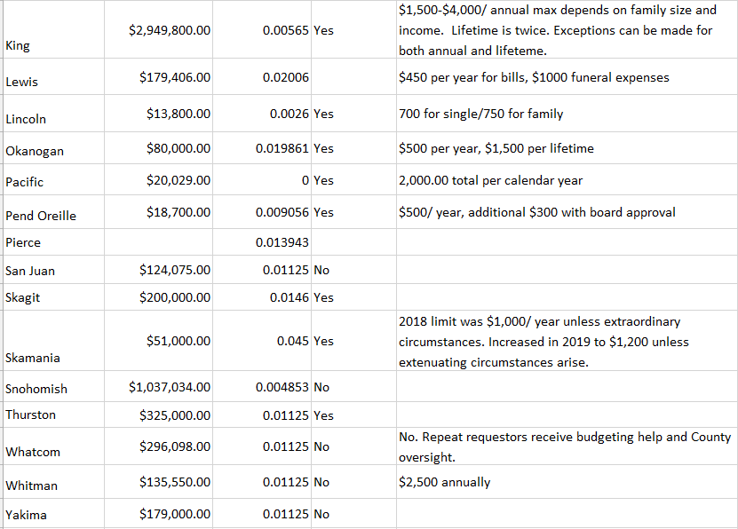
County Veteran Service Officer Program
Levied Funds
73.08.010 RCW County veterans' assistance programs for indigent veterans and families.
This RCW allows for Counties to develop programs to assist veterans that are in need based on criteria set by the individual counties.

Slide 5
County Veteran Service Officer Program
Veteran Advisory Boards
It all starts with an Advisory Board to provide direction and guidance
RCW 73.08.035
Veterans' advisory boards.
(1) The legislative authority for each county must establish a veterans' advisory board. Upon its establishment, the board shall advise the county legislative authority on the needs of local indigent veterans, the resources available to local indigent veterans, and programs that could benefit the needs of local indigent veterans and their families.
(2) The county legislative authority must solicit representatives from either local branches of nationally recognized veterans' service organizations or the veterans' community at large, or both, to serve on the board. No fewer than a majority of the board members shall be members from nationally recognized veterans' service organizations and only veterans are eligible to serve as board members.
(3) Service on the board is voluntary. The county legislative authority may provide for reimbursement to board members for expenses incurred.

Slide 6
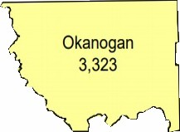
County Veteran Service Officer Program
Program Outline
County Commissioners
County Veterans Advisory Board
Accredited through
County Veterans Service Officer

Slide 7
County Veteran Service Officer Program
Program Outline
County Service Officer Programs were designed to aide aging Volunteer Service Officer Programs
County Service Officer Programs create a direct approach to Claims and Service
The program starts with a contract between the County and Washington Department of Veterans Affairs
Then hiring a Veteran Service Officer that will be supported by WDVA
Then getting that Service Officer Accredited through WDVA
Accredited through
County
County Service Officer Program
(Accredited)

Slide 8
County Veteran Service Officer Program
Partnering Agencies
By partnering with area resources we are able to ensure sustainability for the Veteran.
This is done by the use of Release of Information forms developed with Partners.
Notes:
Partnering is imperative due to the size of our budget. We partner with SSVF for housing and long term financial needs of Vets, WDVA for claims processing and grants for Vets in need as well as Home Depot projects, American Legion and VFW Service Officers send us Veterans who need help filing claims for disability compensation, pension, medical or educational benefits
We Partner with three counties around us to ensure that we cover all veterans in our area. Those counties are Ferry, Chelan And Douglas counties and soon we will be helping in Grant.
Regularly attend events throughout the County include the County Fair, County Housing functions, Legislative Meetings in our area, Community Events, Radio Shows are used to showcase events and services.
As Homeless or Financial “At Risk” veterans come through WorkSource, Community Action, or SSVF they are automatically referred to our program to assess what benefits they are not signed up for or receiving. We then ensure that they are signed up for those services.

Slide 9
County Veteran Service Officer Program
Questions

