Slide 1
Mental Health Services in Washington DOC 2019
Bart Abplanalp, Ph.D.
Chief Psychologist – West
Washington State Department of Corrections

Slide 2
Mental Health in Prisons
Pathways through the prison
Assessment of mental health needs
Mental health providers in DOC
Veteran population in prison
Mental health services available (general vs. veterans)
Challenges in Re-Entry

Slide 3
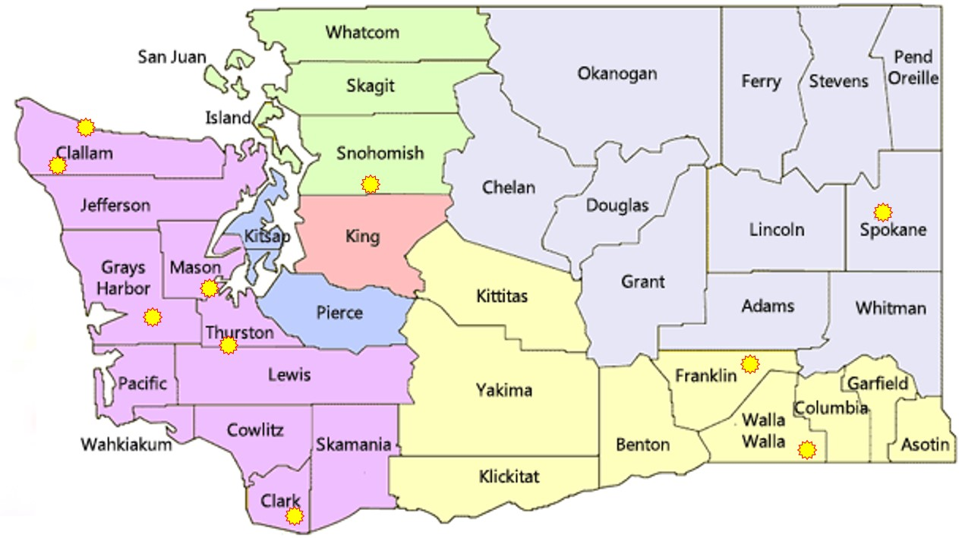
DOC Facility Locations

Slide 4
Gender
Race

Slide 5
Veteran Population in DOC

Slide 6
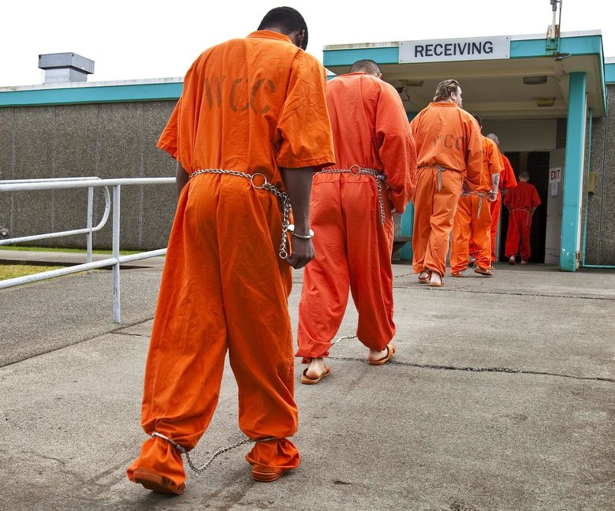
Intake Screening
Occurs at Reception
WCC – Shelton
300-400 per week
WCCW – Gig Harbor
20-40 per week
Mental Health Professional
Masters Level or above
Triage
Self-reported need
Active symptoms
Functional impairment
Behavioral observations

Slide 7
MH Screening
Brief screening tool (<10minutes)
Medications
History of :
Treatment
Hospitalization
MH diagnoses
Current/past :
Medications
MH symptoms
Suicide attempts/ideation
Desire/need for treatment
Behavioral observations

Slide 8
Housing need
GP – General Population
COA – Close Observation Area
RTU – Residential Treatment Unit
Mental Health Appraisal/Assessment need
Urgent – within 24 hours
Routine – within 14 days
PREA concerns
Prison Rape Elimination Act

Slide 9
Prevalence of Mental Disorder
Prison U.S.
Substance abuse 70-90% 5-10%
Antisocial personality 15-50% 1-3%
Mood disorders 15-35% ~10%
Psychotic disorders 10-20% 1-2%
Most disorders are over-represented in correctional settings
Generally accepted figure is that 15-35% of those incarcerated have a major mental disorder
Slightly higher in female populations
Notes:
The take-home message of this slide is that the concentration of mental illness in prisons is SIGNIFICANTLY HIGHER than in the general population. Prisons have come to be known as “the new asylums” in that more folks are receiving treatment for major mental disorders within correctional facilities than through providers in the community and this significantly taxes our already limited resources. It may be helpful to point out that the structure and routine of prisons can often mask some of the more overt symptomatology that would be more readily manifest in the community, where a greater number of stressors and destabilizers might be present.
It is also important to lay the groundwork for the next slide, which points out that although there may be a greater concentration of the mentally ill in prisons, it does not translate into an increased risk for violence with this population and in fact makes these inmates more likely to be the victims of crime or predation due to their level of impairment, degree of distress, and/or lack of organization.

Slide 10
Mental Illness in Prison
1/3 with any potentially qualifying diagnosis (about 50% of women)
22% seriously mentally ill (16% severe mood disorders, 6% psychosis)
About 5% with debilitating symptoms
20% in active Tx (close to 40% of women) – treatment refusal a problem in substantial minority of SMI

Slide 11
Mental Illness in Prison
Substance abuse/dependence problems
At least 75% of WA DOC population
Much higher percentage with history of physical and/ or sexual abuse as children
PTSD is overrepresented –high chance of witnessing or being a victim of violence
Underdiagnosed TBI, FAS/FAE, and other cognitive disorders

Slide 12
Mental Health Treatment
Referral process
Screening triage
Inmate self-referred (“Kite”)
Staff referral
Emergency
Eligibility based on Offender Health Plan (OHP)
Medical necessity
Symptom severity
Functional impairment
CRC and “3 for Free”
Primary Therapist assignment
All inmates in active treatment (typical caseload = 80-100)
MHA, MHU, Treatment Plan

Slide 13
Mental Health Treatment
Case management
Individual therapy
Various orientations
Limited (CBT, CPT, EMDR)
Group treatment
Psychoeducational and process-oriented
Closed and open ended
Examples: anxiety, depression, trauma-focused, DBT
Crisis responding
Psychiatric services
MH is the gatekeeper
Pts seen every 90 days

Slide 14
Challenges for Mental Health in DOC
High caseloads due to concentration of MI in prison
MI is considered a stigma/weakness
MI are much more likely to be the victims of violence and exploitation
Common release problems
$40 gate money
Greyhound bus ticket
30 day supply of meds
Releasing homeless
Felony conviction makes employment and housing difficult

Slide 15
Challenges for Mental Health in DOC
Creating true community-based transition program
Work Release requirements can make it difficult for SMI to succeed
Availability and timeliness of community MH follow-up
Placement into supported living
ORCS is a great example of what can go right

Slide 16
Future Directions
Improved coordination of care – medical/CD
Develop structured psychological Tx
More effective than meds for many conditions
Stronger psychosocial rehab focus in residential
Continue to develop trauma-related services
Stronger training and services directed at suicide prevention
More robust training to be done by MH staff
Improved assessment
Strengthen transitional programming and services
Better community liaison, placement
Expand DOC outpatient services?

