Slide 1
FUBAR-ed? Less than Honorable Discharges, Upgrades, and Benefits Eligibility
Mariah Hanley
Staff Attorney
Northwest Justice Project
Veterans Project
Seattle
Serving Those Who Served: July 18, 2019

Slide 2
Today’s Agenda
1:10-1:50
Basics, Definitions, and Discharges
1:50-2:20
Discharge Upgrades and Eligibility for VA Benefits
Questions will be answered at the end, but don’t hesitate to ask throughout

Slide 3
ABOUT ME
2016 Graduate of the University of Washington School of Law
Staff Attorney at Northwest Justice Project
Specialize in veterans benefits and discharge upgrades
Interned at Northwest Justice Project throughout law school
Veterans Project, Medical-Legal Partnership, RISE Project

Slide 4
ABOUT THE VETERANS PROJECT
The Veterans Project provides free legal assistance to veterans in Western Washington. We have 2 attorneys in Seattle (funded by the King County Veterans, Seniors, and Human Services Levy), one at the VA Hospital at American Lake, and two part-time attorneys (one in Tacoma and one in Bremerton).

Slide 5
ABOUT YOU
Veterans?
Active duty military?
Working with veterans now?
Providing mental healthcare to veterans?
Work with vets with less-than-Honorable COS?

Slide 6
Ending Service
Definition of Veteran
”What’s Your Discharge?”
Options for “Bad Paper”

Slide 7
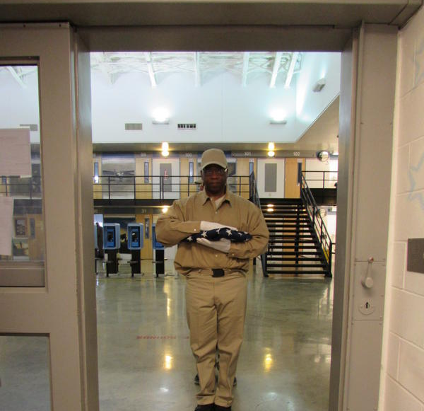
What is your personal definition of “veteran”?
Which of these photos show veterans?

Slide 8
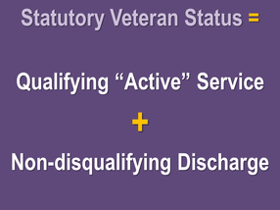
Who is a “Veteran?”
Social Status: Experience
Those who served in the military (or even those who are still serving) can be considered “veterans"
Statutory Status: Eligibility
However, a person can have served (even in combat) and not be considered a “veteran” for purposes of federal, state, and local benefits.

Slide 9
Definitions
Federal: Department of Veterans Affairs healthcare, disability compensation, housing assistance/HUD-VASH, non-service connected pension, home loans, education benefits, federal hiring preference
State: Washington Department of Veterans Affairs benefits, veterans homes, state hiring preference, property tax exemptions
County: Veteran assistance funds, veteran service programs, local benefits and exemptions
All of The Above: Definitions differ between programs, benefits, and departments.

Slide 10
Characterizations of Service
 | Honorable | General (Under Honorable Conditions) | Other than Honorable | Bad Conduct Discharge | Dishonorable /Dismissal | Uncharacterized
Administrative or Punitive | Administrative | Administrative | Administrative | Punitive | Punitive | Administrative
Eligible for Benefits? | Yes | Yes, mostly. Not GI bill. | Possibly, but case-fact specific | Probably not, with exceptions | No | Yes, but the veteran likely didn’t serve long enough to receive benefits
Other Information | Most common |  | Often known as OTH | Often known as BCD | Dismissal is for officers | Given when a veteran didn’t serve long enough for any other COS
% of Discharges with COS | 72.60% | 6.4% | 4.4% | .81% | . 06% | 9.5%

Slide 11
Veteran means a person who served in the active military, naval, or air service and who was discharged or released under conditions other than dishonorable. 38 C.F.R. § 3.1(d), authorized by 38 U.S.C. § 101(2).

Slide 12
Qualifying Active Service
Armed Force + Component + Duration
Armed Force: Must have served in one of the military’s 5 branches
Army, Air Force, Coast Guard, Navy, Marines
Component: Active Duty (qualifies for “active” status), Reserves (qualifies when activated federal service), National Guard (qualifies when activated federal service)
Duration: Often, benefits have duration requirements (180 days, completion of contract, service during a “period of war”)

Slide 13
Non-Disqualifying Discharge
“Under Conditions Other than Dishonorable” = Characterization of Service + Reason for Separation
Characterization of Service: One of six options, used to denote the quality (“characterization”) of a veteran’s time in service.
Vets usually know as their “discharge.”
Advocates may call this a “COS”
Reason for Separation: The narrative reason the veteran was separated from the Armed Forces
A vet who is otherwise eligible for benefits can lose eligibility as a result of a statutory or regulatory bar aligning with their reason for separation

Slide 14
EFFECTS OF “VETERAN” DETERMINATION
Knowing whether someone is a “veteran” for the purposes of federal, state, and local benefits allows advocates to advise clients about their options and challenges they’ll face.
Determining veteran status can be very tricky- can change even within the same level of government.
Example: A veteran who is separated with a ”General Under Honorable” characterization of service is eligible for most VA benefits, but not GI Bill education benefits.

Slide 15
ELIGIBILITY FOR VA HEALTHCARE
Veterans with less-than-Honorable characterizations of service are sometimes still eligible for VA healthcare or benefits
Treatment for a service-connected condition
As a result of a VA Character of Service Determination
Emergency mental healthcare or compassionate care
Vet Centers
Discharge Upgrades

Slide 16
ELIGIBILITY FOR VA HOUSING HELP
Veterans with less-than-Honorable characterizations of service may be eligible for housing assistance
Generally requires healthcare eligibility
VA changed the definition of “veteran” when applied to homeless veterans in 2016
No longer required to have a particular length of service or characterization of service (but no dishonorable discharges or separation because of general court martial)

Slide 17
ELIGIBILITY FOR VA EDUCATIONAL BENEFITS
GI bill requires an Honorable COS
Some veterans have been successful in applying and receiving GI bill without it, but the law is that only veterans with an honorable are eligible
Vocational Rehabilitation is available for veterans with an Honorable or General and veterans with an OTH or BCD COS can ask for eligibility
Dependent educational benefits are available for all veterans except those with a Dishonorable COS

Slide 18
STATE DEFINITION(S):
3 Washington laws define veteran:
RCW 41.04.005 RCW 41.04.007
RCW 73.08.005
County veteran assistance funds may choose to further expand the statutory definition of veteran in some circumstances.

Slide 19
RCW 41.04.005
Veteran is a person who:
Received an honorable discharge, is actively serving honorably, or who was separated for physical reasons with a honorable record, AND:
Served during a wartime period in any branch, as a member of the women’s air forces service pilots, as a US merchant mariner during WWII, or a civil service crew member during WWII, OR:
Received an armed forces expeditionary medal, or marine corps and navy expeditionary medal, for opposed action on foreign soil in any branch or as a WASP

Slide 20
Periods of War
World War I
World War II
Korean Conflict
Vietnam Era (1961-1975 for veterans who served in Vietnam during that era; otherwise 1964-1975)
Persian Gulf War (either 1990-1991 or 1990-1995 if received a campaign medal or badge for that period)
Period beginning on the date of any future declaration of war and ending on a proclaimed date
Armed conflicts if awarded a badge or would have been awarded but for a prior deployment: Lebanon; the invasion of Grenada; Panama, Operation Just Cause; Somalia, Operation Restore Hope; Haiti, Operation Uphold Democracy; Bosnia, Operation Joint Endeavor; Operation Noble Eagle; southern or central Asia, Operation Enduring Freedom; Persian Gulf, Operation Iraqi Freedom; Iraq and Syria, Operation Inherent Resolve; and Afghanistan, Operation Freedom's Sentinel.

Slide 21
RCW 41.04.007
Veteran is a person who:
Received an honorable discharge, received a discharge for medical reasons with an honorable record, or possesses a DD214 or NGB 22 with an honorable COS, AND served:
As a member in any branch (including National Guard and Reserves) and fulfilled initial military service obligation, OR
As a WASP, OR
As a member of the Reserves, Coast Guard, or National Guard who was called into federal service for at least 180 cumulative days, OR
As a civil service crew member aboard a US Army or Navy transport service or vessel, or as a member of the Philippine armed forces/scouts during World War II, OR as a US documented merchant mariner, OR
As a US documented merchant mariner who received a military commendation and served during the Korean Conflict or Vietnam conflict

Slide 22
RCW 73.08.005
Veteran is a person who:
Served in the active military, naval, or air service, as a WASP during WWII, or a US merchant mariner or civil service crewmember in WWII, AND
Served on active duty for at least 180 days and received an honorable COS OR
Received a general or honorable COS with a medical reasons for separation for a condition that did not exist prior to service (no # of days requirement) OR
Received an honorable and receives Disability Compensation from VA (no #of days requirement) OR
A current member in the reserves or national guard and is activated, fulfilled their initial service obligation and released with an honorable, or does not have 180 days but meets federal definition of a veteran with 20+ years

Slide 23
ELIGIBILITY FOR WDVA STATE VETERANS HOMES
Veterans are eligible for care at a state veterans home with an Honorable COS
Spouses or surviving spouses and Gold Star Parents are also eligible for care at a state veterans home
VA may pay for state veterans home care, depending on rating and disability
Dependent educational benefits are available for all veterans except those with a Dishonorable COS

Slide 24
ELIGIBILITY FOR STATE VETERANS PREFERENCE
Veterans with an Honorable COS or medical discharge with Honorable record are eligible for veterans hiring preference in Washington
Scoring depends on period of service, receipt of retirement pay, and reserve status if previously employed by WA
Veterans can be given priority over other similarly-qualified candidates
Surviving spouses or spouses of totally disabled veterans also receive preference

Slide 25
Eligibility and upgrades
Discharge Upgrades
VA Character of Service Determinations

Slide 26
DISCHARGE UPGRADES
A discharge upgrade is a review of the veteran’s character of service by their former branch
A successful discharge upgrade modifies the veteran’s DD214
DOD or DHS (Coast Guard) process, not through VA
Less-than-Honorable COS are known as “bad paper”

Slide 27
Who Applies for a Discharge Upgrade?
Any veteran who believes their characterization of service does not adequately define their time in service

Slide 28
Discharge Review Board
Army
Navy (Marines)
Board for Correction of Military (Naval) Records
Air Force
Army
Coast Guard
Air Force
Navy (Marines)
Coast Guard

Slide 29
 | Discharge Review Board (10 U.S.C. 1553) | Board for Correction of Military (or Naval) Records (10 U.S.C. 1552)
What can the Board do? | Change characterizations of service and reasons for separation. Cannot apply if separated by general court-martial. | Change characterizations of service, reasons for separation, and change discharge to or from disability or retirement.
What can’t the Board do? | Can’t lower characterizations of service, change re-enlistment codes, make decisions about disability and retirement, reinstate veterans into military service, or recall any person to active duty. | Can’t lower characterizations of service, compel attendance of witnesses, expunge a general or court-martial conviction, or award payments to veterans for preparing the application.

Slide 30
Impropriety (DRB) | Error (BCMR)
Did the military do something wrong? Is the policy different today and expressly retroactive?
Inequity (DRB) | Injustice (BCMR)
Was it fair to the veteran? Were there mitigating circumstances? Is the policy different today and not expressly retroactive?
Clemency (DRB and BCMR)
What has the client done since discharge that makes their separation obviously unjust?

Slide 31
Rates of Success
Branch | Discharge Review Board | Board for Correction of Military (Naval) Records
Air Force | 19% | 20%
Army | 41% | 10-15%
Coast Guard | 1% | 15-20%
Navy | 4% | 15-20%
The rates of success vary considerably between branches and boards
Rates of success increased dramatically after implementation recent DOD memoranda
Rates of success increase when applicants have a lawyer

Slide 32
Statute of Limitations
Discharge Review Board
Board for Correction of Military (Naval) Records
15 years after discharge.
Must apply to DRB first if eligible.
Cannot be waived
3 years after DRB decision or after “error or injustice” is discovered
Can be waived if in the “interest of justice.”
In practice: SOL waived in successful applications

Slide 33
DOD Memoranda
“Hagel,” “Kurta,” and “Wilkie” memos are intended to assist veterans with misconduct related OTH COS and PTSD or related mental health issues
Supposed to improve how boards look at these cases
Increased the rate of approval for DUs (but not always applied correctly by Boards)

Slide 34
Don’t Ask Don’t Tell
Repealed in 2011
As of June 2016, less than 8% of veterans separated under DADT applied for a discharge upgrade
September 2011 memo directed Boards to “normally grant requests” for upgrade so long as:
The original discharge was based “solely” on DADT or a similar policy in place pre-DADT
There were no “aggravating factors” such as misconduct

Slide 35
Military Sexual Trauma
MST: A term used by the VA to cover a wide range of unwanted sexual contact while in service
MST can be a mitigating factor in discharge
It can cause PTSD, contribute to a decision to go AWOL, or be used as a cover for command discrimination

Slide 36
Va Character of Service Determinations (VA CSD)
The VA decides that a veteran’s service, despite their characterization of service, was honorable for VA purposes.
Grants the veteran access to VA benefits and healthcare
Does not grant the veteran access to GI Bill benefits
Doesn’t change DD214
Available for veterans with Other than Honorable, Bad Conduct Discharge (if not by general court-martial) and Uncharacterized characterization of service

Slide 37
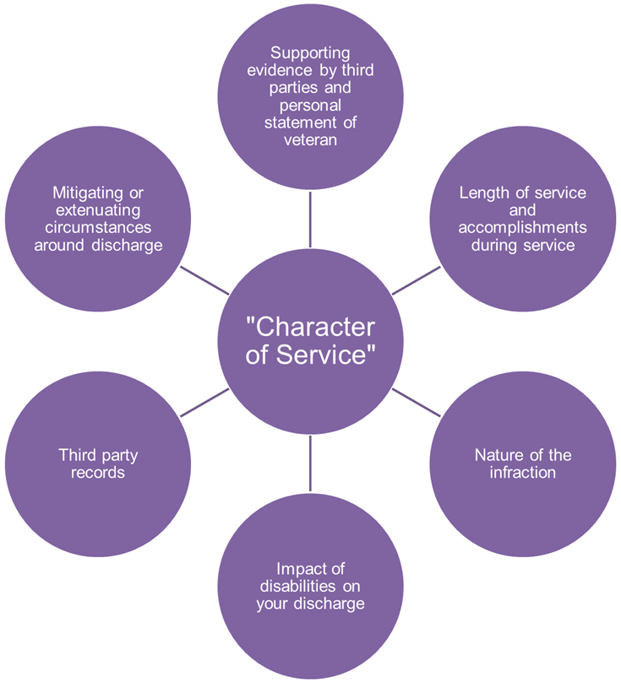
Va Character of Service Determinations (VA CSD)
Veterans can apply for both a VA CSD and a Discharge Upgrade
VA CSDs are faster, easier, and have a higher rate of success

Slide 38
Statutory and Regulatory Bars
Statutory Discharged by general court-martial Conscientious objector Desertion Resignation by an officer for the good of the service AWOL for a continuous period of 180 days or more without a good reason why (decided by the VA) Requesting release from service as an alien during a period of hostilities
Regulatory Other than Honorable characterization of service in lieu of court-martial Mutiny or spying Due to an "offense of moral turpitude" (usually a felony) Willful and persistent misconduct Homosexual acts involving aggravating circumstances or factors affecting the performance of duty

Slide 39
Questions?

