Slide 1
A Complementary Approach
Five Tools
Jaime Yslas
RYT-200
VYP Ambassador
July 18, 2019

Slide 4
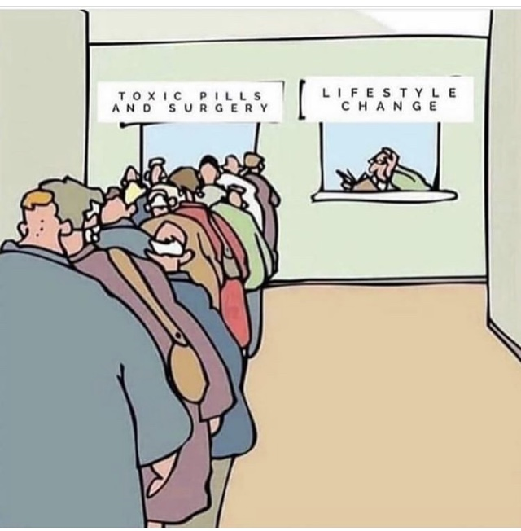

Slide 5
http://drwaynejonas.com/wp-content/uploads/2017/09/Therapeutic-Yoga-Pocket-Guide.pdf

Slide 6
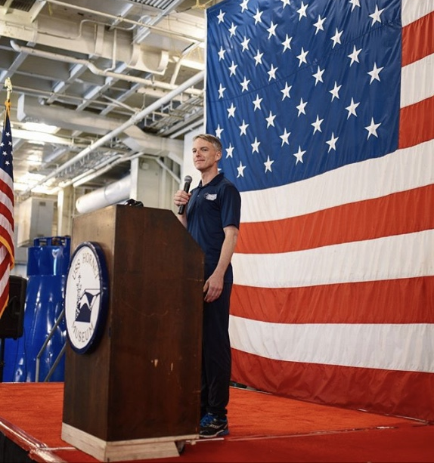

Slide 7
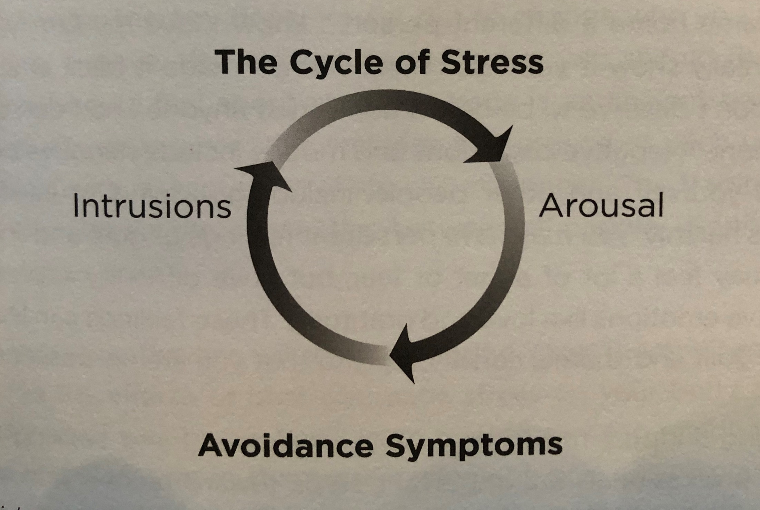

Slide 8
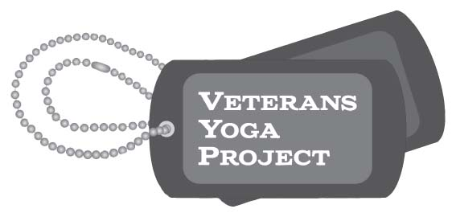
S P A C E
breathe easy,
focus clearly,
move freely,
rest deeply, and
remember what is
working in our lives
Safe
Predictable
And
Controllable
Environment

Slide 9
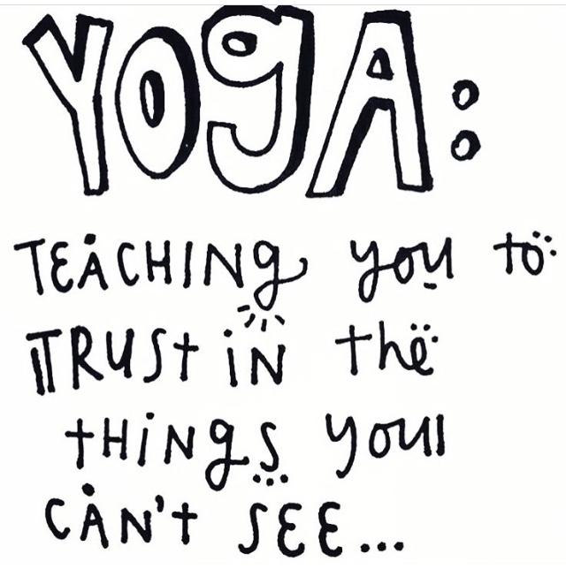

Slide 10
Mindful Resilience as a complement
to PTSD treatment

Slide 11
Phase-Oriented Approach to PTSD Treatment
Phase 1 Stabilization and Symptom Reduction
Phase 2 Processing or “Digesting” the Trauma
Phase 3 Integration and Post-Traumatic Growth
Mindful Resilience as a complement
to PTSD treatment

Slide 12
Stabilization and Symptom Reduction
- direct positive effects on autonomic nervous system
- decrease in current symptoms
- better ability to cope with the stresses of being in treatment
- co-morbid symptoms including depression and chronic pain
Mindful Resilience as a complement
to PTSD treatment

Slide 13
Processing or “Digesting” the Trauma
- often an increase of symptoms during this phase
- tools may ease the stress of verbal processing of trauma memories
Mindful Resilience as a complement
to PTSD treatment

Slide 14
Integration and Post-Traumatic Growth
- wellness practice
- sharing the tools with others in recovery
Mindful Resilience as a complement
to PTSD treatment

Slide 15
Mindful Resilience
A treatment protocol consisting of 5 tools for self-regulation.
These practices help you:
Breathe Easy
Focus Clearly
Move Freely
Rest Deeply
Be Grateful
Notes:
Not a cure for PTSD, Simply a set of tools:
Breathwork to help the veteran breath easy
Meditation to help the veteran focus clearly
Mindful Movement to help the veterans move freely
Guided Rest to help the veteran rest deeply
And Gratitude to help the veteran develop an attitude of acceptance and appreciation

Slide 16
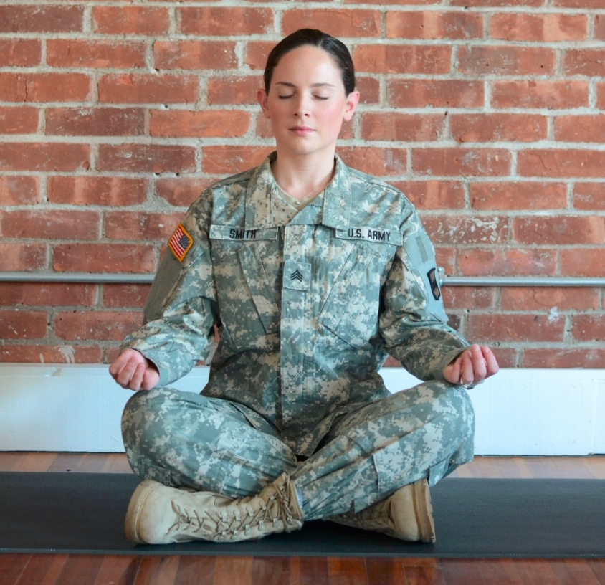
Breathing
“Being able to consciously shift from a hyper arousal/vigilant state to a calm rational state gave me the strength to handle my day” ~Kyle, USMC

Slide 17
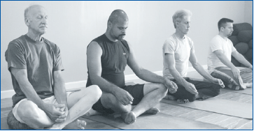
Meditation
“Now I don’t ruminate, I meditate” ~Jim, Veteran
Notes:
Being able to consciously shift from a hyper arousal/vigilant state to calm rational thought gave me the strength to handle my day

Slide 18
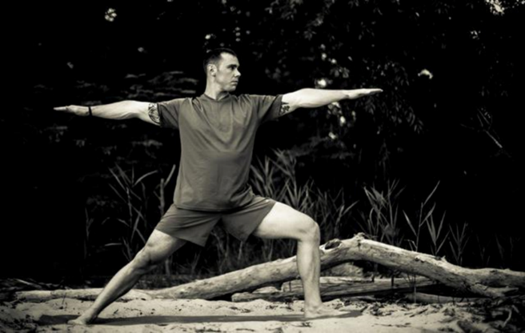
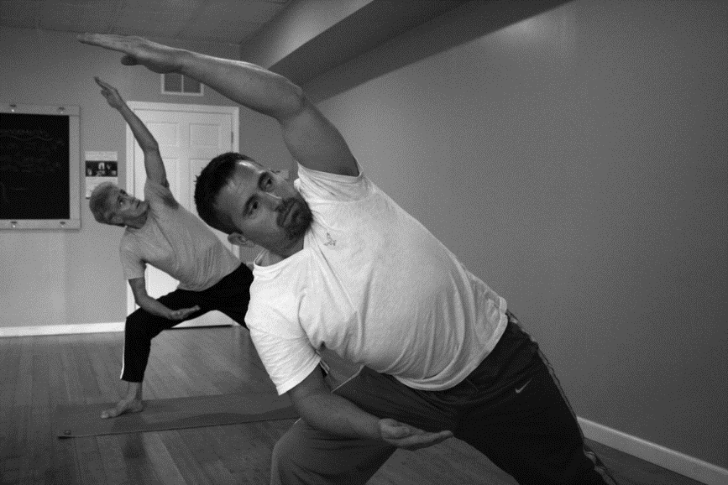
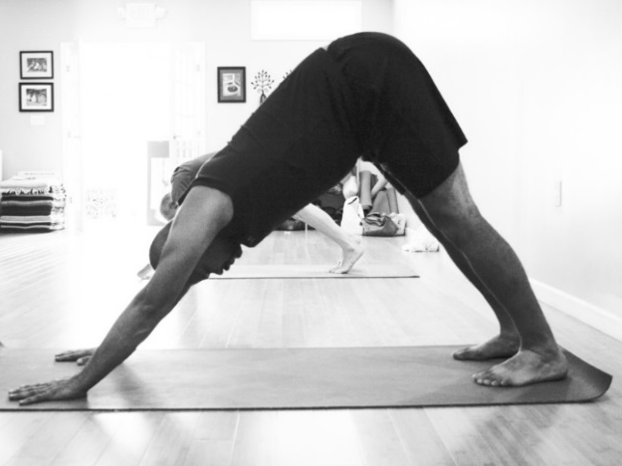
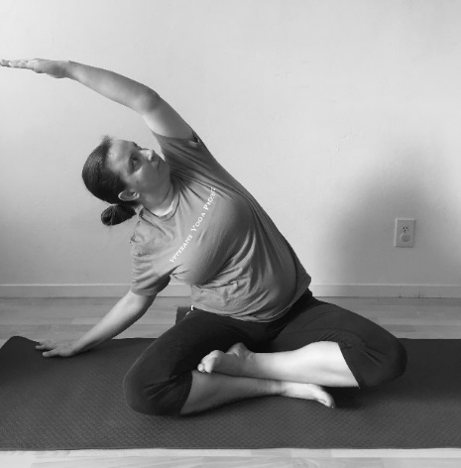
Mindful Movement
“The mindfulness yoga turned out to help me refocus on the here and now, and what's important.” ~Jack, Vietnam Veteran

Slide 19
Guided Rest and Relaxation
“I use yoga nidra every night to help me sleep” ~Chris, OEF/OIF Veteran

Slide 20
Gratitude
“I have much to be grateful for. I am free to be kind and feel compassionate to myself and others. I am so much more than 12 months and 21 days of my life in Vietnam. I forgive myself”
~Daniel, Veteran of the War in Vietnam

Slide 22
https://www.veteransyogaproject.org/accountability

Slide 24
Complementary Protocol Additional Resources

Slide 29
VYP Practice Library
VYP “Find a Class”
Veterans Yoga Project Website

Slide 30
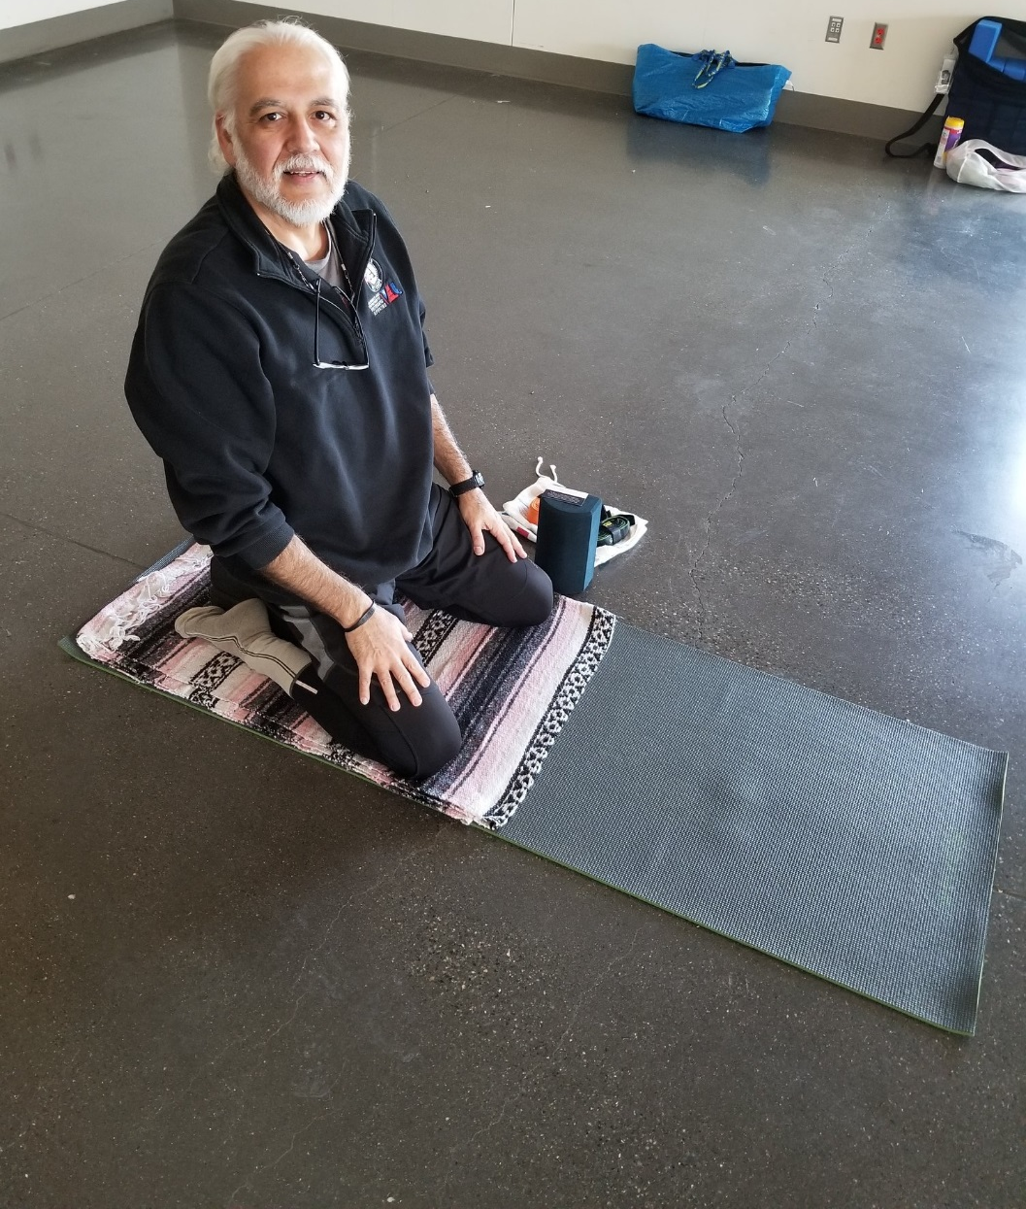
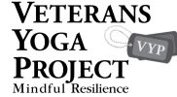
For more information:
Jaime Yslas, RYT-200
jaime.yslas@veteransyogaproject.org
360-348-1684
https://www.veteransyogaproject.org/
The only Zen you can find
on the tops of mountains is
the Zen you bring up there.
Robert Pirsig

