Slide 1
Washington State Military Transition Council
APPRENTICESHIPS
Rachel Roberts
APPRENTICESHIP TRACK COORDINATOR

Slide 2
Today’s Agenda
WSMTC
Labor Needs
WA Veteran Apprenticeship STATs
What is an Apprenticeship
GI Bill
WDVA Programs
Resources

Slide 3
Washington Military Transition Council
Executive Order 13-01
5% of procurement contracts to certified veteran-owned businesses
VERG – Veteran Employee Resource Group
Washington Military Transition Council
Collaboration federal, state, local agencies, private, and non-profit help transitioning assistance
Executive Order 19-01
Career Assistance Vets, SM, Guard/Reserve, & Families
Credentialing – Expedite procedures
Employment Plans – Plans to increase employment
Equal Employment Opportunity – Selection process

Slide 4
Labor Needs
Changing the messaging
1/2/7 Model –
1 Masters Degree occupation
2 University Degree
7 skilled technician
College for All ☹ = Post High School Credential for All ☺
Aging Workforce

Slide 5
Labor Needs
Looking Forward – WA Growth Rate
Upcoming Projects
Puget Sound Transit
25 year expansion plan
62 miles of new rail
$52 billion
Ports
$1.2 billion
665,100 - 1,046,900 labor hours/year
3,700 – 6,000 people
Corrections Facilities
EIW – $1.2 billion
Aerospace
1,350 aerospace-related companies / 35 out of 39 counties

Slide 6
Apprenticeship vs College
Apprenticeship
Get paid for on-the-job training.
EARNINGS $18-$24/Hour to start
YEAR 1 $37,440 - $49,920+ Benefits
YEAR 2 $41,600 - $54,080+ Benefits
YEAR 3 $45,760 - $58,240+ Benefits
YEAR 4 $49,920 - $62,400+ Benefits
TOTAL OVER 4 YEARS - $174,720 - $224,640 Earnings + Benefits & Pension
WORK EXPERIENCE - 4 years in the industry
College
Pay for classroom learning.
COST $22,500/Year
YEAR 1- $22,500Debt
YEAR 2- $22,500Debt
YEAR 3- $22,500Debt
YEAR 4- $22,500Debt
TOTAL OVER 4 YEARS - $90,000 Debt
WORK EXPERIENCE - 0 years in the industry

Slide 7
Veteran Apprenticeship Stats
Ten percent of all apprentices are Veterans

Slide 8
Veteran Apprenticeship Stats
Completion rates around 45%. Similar rates of veterans & non veterans.

Slide 9
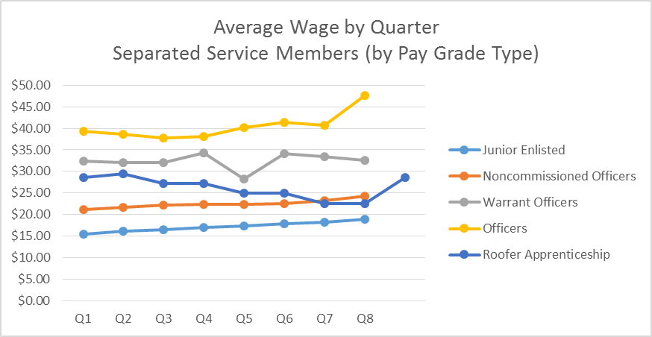
Veteran Apprenticeship Stats
Wage by Quarter
Roofer Apprenticeship Wage by Quarter w/ GI Bill®
Q1 | Q2 | Q3 | Q4 | Q5 | Q6 | Q7 | Q8 | Q9
$28.67 | $29.53 | $27.22 | $27.22 | $24.91 | $24.91 | $22.59 | $22.59 | $28.53

Slide 10
Apprenticeship
Industry Driven Training Model
Combination school, RSI, typically 144 hours
OJT learning, typically 3-5 years or 2000-5000 hours
C2C video - http://c2c.edgefactor.com/wlregister.aspx
WA STATS
12,736 active apprentices in over 600 occupations
Over 7,500 Employers
Veteran Apprentices 10%
Women Apprentices 9%
Average Age Apprentice: 28

Slide 11
Apprenticeship
Major Apprenticeship Industries
Construction
Aerospace
IT
Maritime
Railroads
Upcoming Industries
Healthcare
Banking/Insurance
Safety
Nursing
HR

Slide 12
Apprenticeship
Tactile Learning
Team Work
Formalized Structure
Ability to Take/Give Commands
Leadership
Discipline
Trust
Purpose

Slide 13
Apprenticeship
Avenues of Approach
Pre-Apprenticeships
ANEW, PACE, PACT, Manufacturing Academy, CSP’s
Veteran Preference/Direct Entry
Labor Market Dependent, Apprenticeship Dependent
Helmets2Hardhats
College Certificates
Apply

Slide 14
Apprenticeship
Considerations
Prior Experience – USMAPS
Credentialing – COOL
College Credits – AA
Challenges – Can be seasonal and labor market dependent
Health Care Packages
Union vs. Non-Union pros/cons
Employer First Model

Slide 15
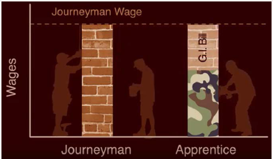
Pay & Post 9/11 GI Bill®
State Approval Authority
Washington Student Achievement Council (WSAC)
Apprentice wage
50% to 70% journeypersons wage
Wage increases at regular intervals
GI Bill benefits
State 100% benefit, decreases 20% every 1000 hours
Based on the zip code of the training location
EXAMPLE APPRENTICESHIP PAY
Time | Hourly Rate WITHOUT GI BILL | Hourly Rate WITH GI Bill
6 Months | $25.68 | $35.90
12 Months | $27.52 | $35.70
18 Months | $29.35 | $35.48
24 Months | $31.19 | $35.27
30 Months | $33.02 | $35.06
36 Months | $34.86 | $36.90
GI Bill Breakdown:
100% - 1-6 months
80% - 6-12 months
60% - 12-18 months
40% - 18-24 months
20% - 24-30 months
*Usage Optional

Slide 16
Military Initiatives
Career Skills Programs (CSPs)
Monthly Skilled Trades Rotation
Apprenticeship Workshops
Brown Bag Lunch Briefings
Prison Re-Integration
Homelessness Re-Integration

Slide 17
Resources
WDVA Resource Guide - http://wacareerpaths.com/apprenticeships/
City of Seattle Resource Guide - http://www.seattle.gov/Documents/Departments/FAS/PurchasingAndContracting/Labor/ApprenticeshipGuidebook.pdf
LNI - http://www.lni.wa.gov/TradesLicensing/Apprenticeship/
Construction Center of Excellence - https://www.constructioncenterofexcellence.com/construction-data-dashboards
ESD Microsite - https://worksourcewa.com/microsite/Content.aspx?appid=MGSWAAPPREN&pageType=simple&seo=landingpage
AJAC - http://www.ajactraining.org/
Apprenti - https://apprenticareers.org/
WASC - http://www.wsac.wa.gov/veterans
GI Bill Comparison Tool - https://www.vets.gov/gi-bill-comparison-tool/
Women - http://womeninapprenticeship.org/

Slide 18
Career Skills Programs
Employment Support Training
Education
Funding Workshops
Pre-requisite:
WA State Residents
Transition (Non Retiree)
Medical discharge eligible
5 Week course
GI Bill funded
Employment Support
Employment Support: “Pre-hire letter”
12 Week course:
Land Management/ Conservation
GS 05/09 placement
Employment Support: WA & OR
Pre-requisite : Employer screening
16 Week Courses: Cloud Server / Data Base
GI Bill /C2C funded
Employment Support
Pre-requisite:
College Algebra (passed)
MTA Test 70%+
18 Week courses:
Welding or HVAC/R
Union funded
Union Placement
Pre-requisite:
Interview w/Union
7 Week course:
Elect. Tower maintenance
GI Bill funded
Employment Support
Pre-requisite:
Endurance / heights
6 week courses: 1. Customer Service
2. Information Tech 3. Business Management
SM, Veteran & Spouses
Grant funded
Employment Support
4 Week courses:
Industrial Coating
Industrial Glazing
C2C / Union funded
Union Placement
4 Week course
Roofing construction
Grant funded
Employment Support
Pre-requisite:
Endurance / heights
Interview w/provider
12 Week internship:
Corporate internship C2C / US Chamber funded
Employment support
Pre-requisite:
AA or BA Degree
Record of leadership
8 Week course:
A&P Credentialing
C2C funded / GI Bill Employer support
Pre-requisite:
FAA 8610-2 form
General Maintenance Test MOS/ Rate/ AFSC (15 Series)
5 - 8 Week course
GI Bill funded
* Stackable Certificates
Employment support post graduation

