Slide 1
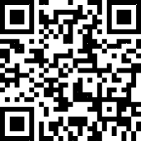
VA Summit on Behavioral Health
A Veteran’s Journey ⏐ 12th Annual
Our Sponsors
Register now!
Sept 13, 2024
8 a.m. to 4:30 p.m.
Highline College
2400 S. 240th Street
Des Moines, WA 98198
In person event for the first time in four years.
Join us for this annual event where VA, DoD and Community Providers in Puget Sound share information on topics related to Veterans and transitioning service members.
For more information contact:
Carl.Duman@va.gov
Lesley.Babb@va.gov
CEs available
https://www.eventsquid.com/event/25135

